Slide 1
Question Formation
Simple Present Tense Question Formation Presentation © 2025 by Tiffany Kearns is licensed under CC BY-NC-SA 4.0.
To view a copy of this license, visit https://creativecommons.org/licenses/by-nc-sa/4.0/
Notes:
This video will review question formation for the simple present tense.

Slide 2
Do you like pizza ?
Yes
or
No
?
/
Questions
Do I
Do you
Do we
Do they
Main verb (base form)
Does she
Does he
Does it
Main verb (base form)
Notes:
-Do you like pizza? Yes or No? When forming yes/no questions, use do for the subjects I, you, we and they. Use does for the subjects she, he, and it. Then, follow with the main verb in the base form.

Slide 3
Question
Short Answer
Yes, I do.
No, I don’t.
_______
Yes, we do.
No, we don’t.
Do we like pizza?
_______
Do they like pizza?
Yes, they do.
No, they don’t.
_______
Does he like pizza?
Yes, he does.
No, he doesn’t.
Yes, she does.
No, she doesn’t.
Does she like pizza?
Does he likes pizza?
Notes:
Do you like pizza? Let’s see more examples: Do we like pizza? Do they like pizza? Remember to use the base form of the main verb. We can answer with Yes, I do or No, I don’t. Yes, we do. Or No, we don’t. and Yes, they do or No, they don’t. But what about this: Does he like pizza? Does she like pizza? Yes he does. Or no he doesn’t. Yes she does, or No she doesn’t. Notice that for the third person singular he and she, the main verb does not have an ‘s’ in question form. The ‘s’ is part of ‘does’. It would be incorrect to write Does he likes pizza?

Slide 4
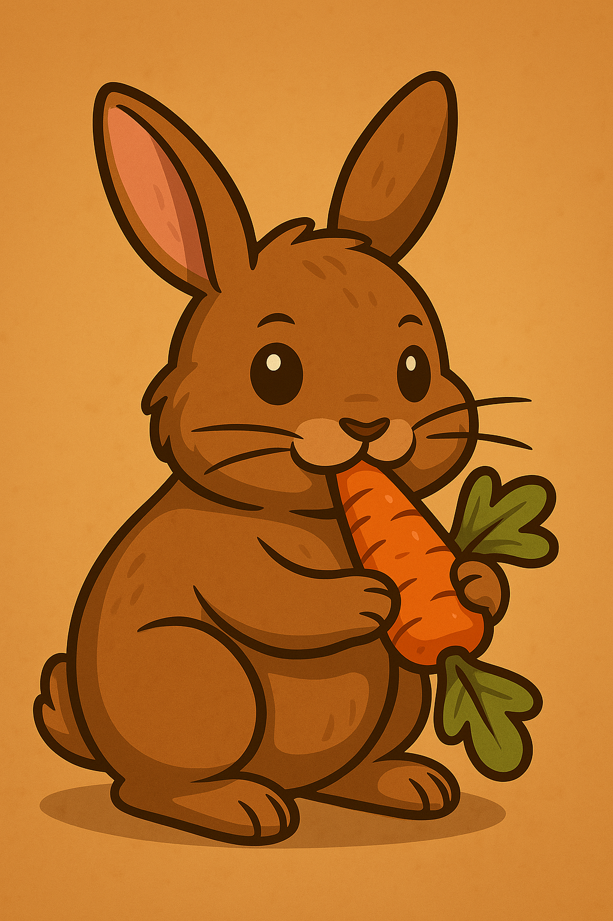
Information Questions
Question Word
do/does
Subject
Main Verb
Where
do
you
live?
What
do
rabbits
eat?
When
does
Mei
study?
What time
does
the bus
arrive?
Notes:
- Now, let’s review information questions in the simple present with the verb –do. Question words include: -Where, What, When, and What Time
After the question word, we use do or does, then the subject and then the base form of the main verb. For example: Where do you live? What do rabbits eat? When does Mei study? What time does the bus arrive?

Slide 5
Question
Long Answer
Where do you live?
What do rabbits eat?
When does Mei study?
What time does the bus arrive?
I live in Port Moody.
Rabbits eat carrots.
Mei studies in the morning.
It arrives at eight o’clock.
Notes:
With information questions, the answer is often longer -because it is giving information. Let’s look at some answers to the previous questions. Where do you live? I live in Port Moody. What do rabbits eat? Rabbits eat carrots. When does Mei study? Mei studies in the morning. What time does the bus arrive? It arrives at eight o’clock. Again, notice how the 3rd person singular subjects have an ‘s’ on the main verb in the answer, but not in the question. The ‘s’ is part of ‘does’ in the question.

Slide 6
Do you like pizza?
What do you like on it?
Where do you order from?
Simple Present Tense Question Formation Presentation © 2025 by Tiffany Kearns is licensed under CC BY-NC-ND 4.0.
To view a copy of this license, visit https://creativecommons.org/licenses/by-nc-nd/4.0/
Notes:
So, I’m still wondering – Do you like pizza? What do you like on it? And where do you order it from? Thanks for watching!

