Slide 1
For Daily Routines and Habits
Simple Present Tense For Daily Routines and Habits Presentation © 2025 by Tiffany Kearns is licensed under
CC BY-NC-SA 4.0.
To view a copy of this license, visit https://creativecommons.org/licenses/by-nc-sa/4.0/
Notes:
This video will review the simple present tense used for daily routines and habits, as well as frequency adverbs which tell how often someone or something performs a routine or habit.

Slide 2
Singular
Plural
1st Person
I speak
We speak
2nd Person
You speak
You speak
She speaks
They speak
3rd Person
s
He speaks
s
It speaks
s
Notes:
Remember, when we form the simple present tense in English, we can make it singular or plural. For example, I speak is singular. We speak is plural. These are 1st person forms. You speak is singular if I am talking about one person, and You speak is plural if I am talking about more than one person. These are the 2nd person forms. She speaks, he speaks, and it speaks are all singular – notice that we need to add an ‘s’ for these 3rd person forms. But we do not need to add an ‘s’ for the plural 3rd person form – they speak.

Slide 3
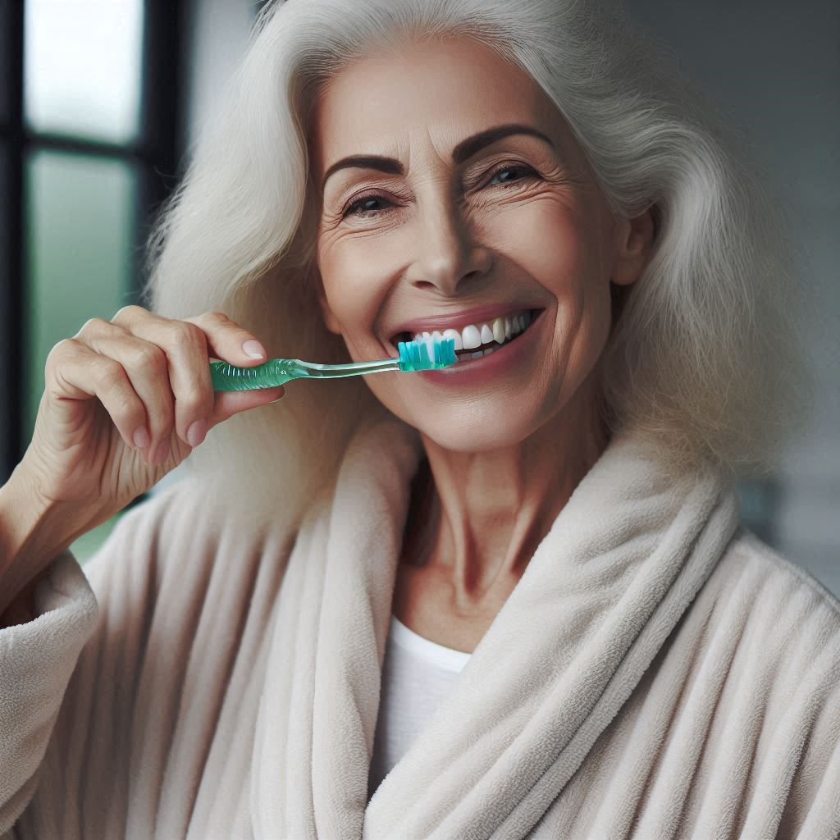
Daily Routines and Habits
eat
brush teeth
wake up
drive to work
walk
Notes:
Some common daily routines or habits include usual activities such as wake up, eat breakfast/lunch/or dinner, brush teeth, drive to work, walk to the bus stop…

Slide 4
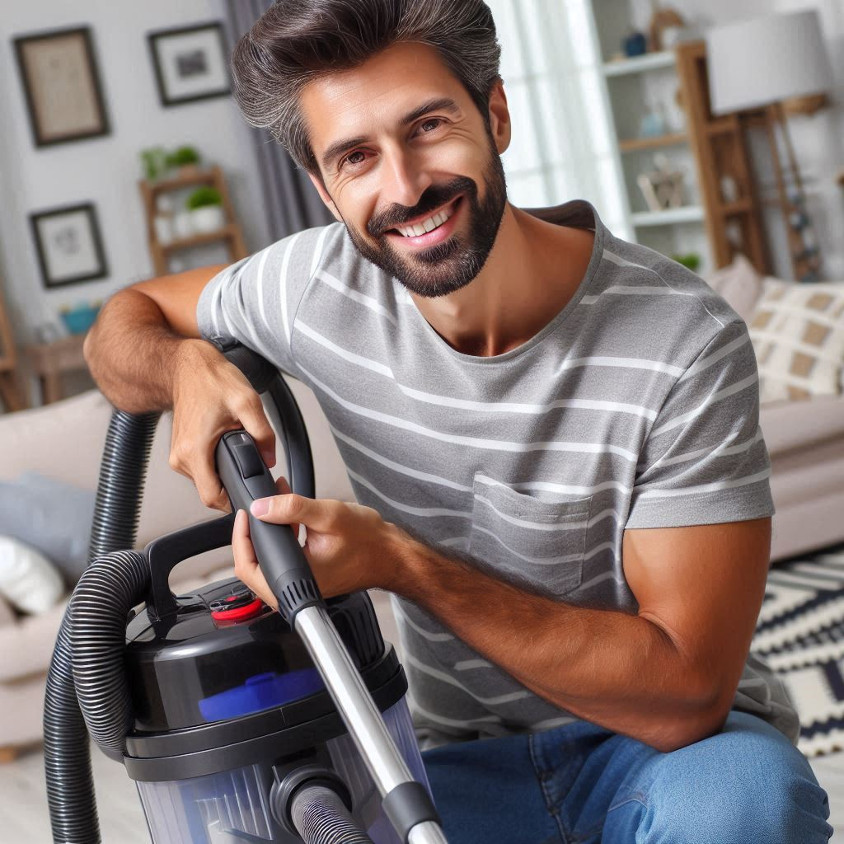
Daily Routines and Habits
take care of
check email
do chores
meet a friend
go to bed
Notes:
… check email, do chores, take care of a child or a pet, meet a friend, and go to bed – just to name a few!

Slide 5
Frequency Adverbs
{
}
always
usually
often
sometimes
seldom
rarely
never
always
usually
often
sometimes
seldom
rarely
never
100%
99%-90%
90%-75%
75%-25%
25%-10%
10%-1%
0%
Subject
+
+
Verb
Tiffany
always
drinks coffee.
Notes:
Frequency adverbs are often used with simple present to help talk about daily routines and habits. Always, usually, often, sometimes, seldom, rarely and never. The percentages are just a guideline but can help you remember the frequency strength. Put the frequency adverb between the subject and the simple present tense verb of the sentence. For example, Tiffany always drinks coffee.

Slide 6
Frequency Adverbs
{
}
always
usually
often
sometimes
seldom
rarely
never
Subject
+
+
Verb
Tiffany
always
drinks coffee.
Notes:
Frequency adverbs are often used with simple present to help talk about daily routines and habits. Always, usually, often, sometimes, seldom, rarely and never. The percentages are just a guideline but can help you remember the frequency strength. Put the frequency adverb between the subject and the simple present tense verb of the sentence. For example, Tiffany always drinks coffee.

Slide 7
Sun.
Mon.
Tues.
Wed.
Thurs.
Fri.
Sat.
Tiffany always drinks coffee.
_____
Ken usually drinks coffee.
_____
Masi often drinks coffee.
_____
Ali sometimes drinks coffee.
_____
Natalia seldom drinks coffee.
_____
Aaron rarely drinks coffee.
_____
Fatima never drinks coffee.
_____
Notes:
Let’s think about a regular week Sunday, Monday, Tuesday, Wednesday, Thursday, Friday, and Saturday. As we know, Tiffany always drinks coffee. But Let’s see some others… Ken usually drinks coffee. Masi often drinks coffee. Ali sometimes drinks coffee. Natalia seldom drinks coffee. Aaron rarely drinks coffee. And, Fatima never drinks coffee.
-Notice how the verb drink ends in ‘s’. Remember this is because all the subjects – Tiffany, Ken, Masi, Ali, Natalia, Aaron and Fatima are all singular 3rd person subjects.

Slide 8
always
usually
often
sometimes
seldom
rarely
never
Simple Present Tense For Daily Routines and Habits Presentation © 2025 by Tiffany Kearns is licensed under
CC BY-NC-SA 4.0.
To view a copy of this license, visit https://creativecommons.org/licenses/by-nc-sa/4.0/
Notes:
So, What everyday activities and routines do you always, usually, often, sometimes, seldom, rarely, and never do? Thanks for watching!

