Slide 1
Simple Past
Regular Verbs
Simple Past – Regular Verbs Presentation © 2025 by Tiffany Kearns is licensed under CC BY-NC-SA 4.0.
To view a copy of this license, visit https://creativecommons.org/licenses/by-nc-sa/4.0/
Notes:
This video will review simple past form for completed actions with regular verbs.

Slide 2
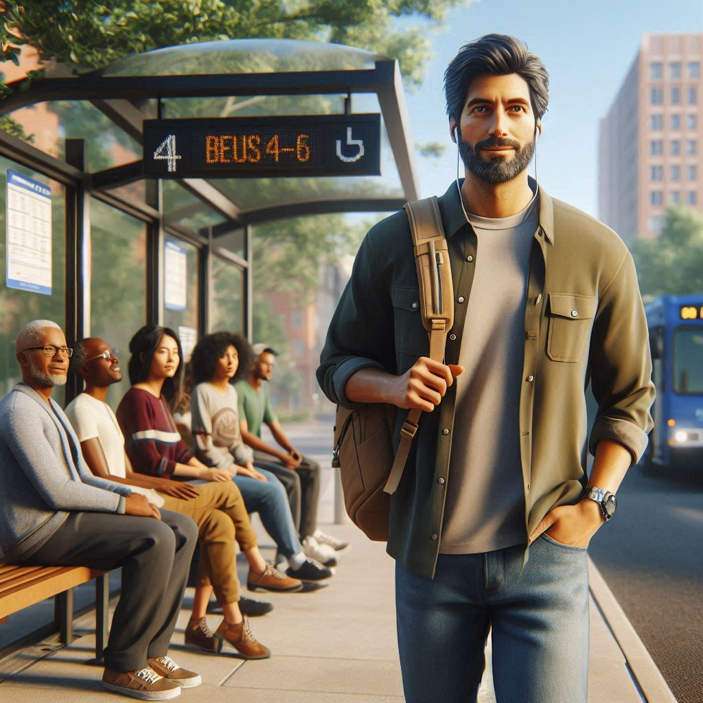
Simple Past with Regular Verbs
Subject
main verb + -ed
Edgar
walked
to the bus stop yesterday.
Routine or Habit
Simple Present
Edgar walks to the bus stop everyday.
Notes:
To form the simple past with regular verbs, we start with the subject and then the verb with an -ed ending. For example Edgar walked to the bus stop yesterday. Remember, we often use time expressions with simple past. In this case yesterday. Compare this to a -simple present sentence – Edgar walks to the bus stop everyday. If something is done everyday it is a routine or habit and we use simple present. If something was done yesterday, it is a completed action in the past and we use simple past.

Slide 3
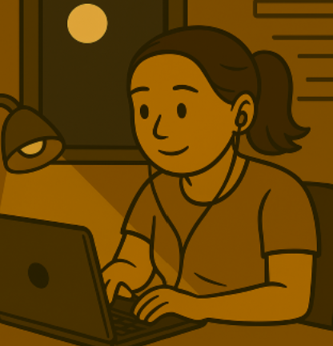
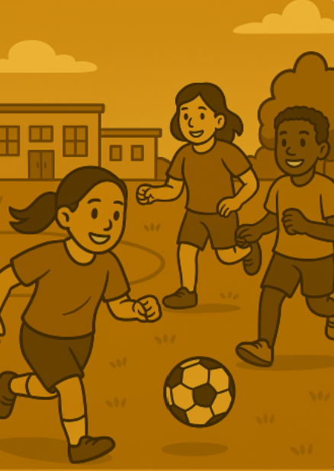
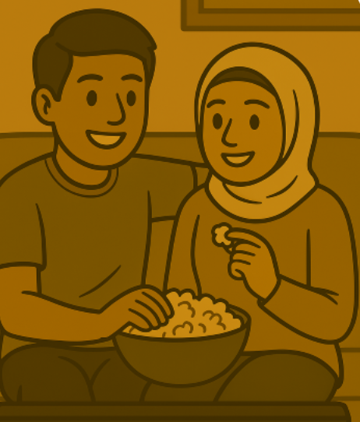
work
play
watch
She worked late last night.
They played soccer after school.
They watched a movie together.
Notes:
Some other common regular verbs include: work – She worked late last night, play – They played soccer after school. Watch – They watched a movie together

Slide 4
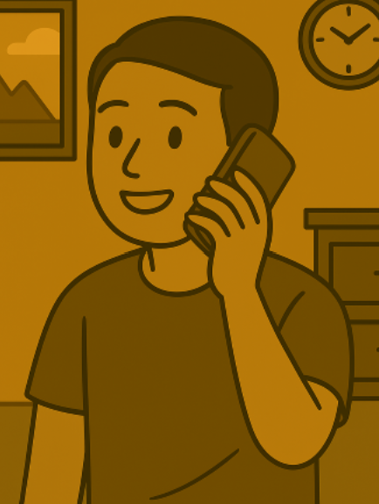
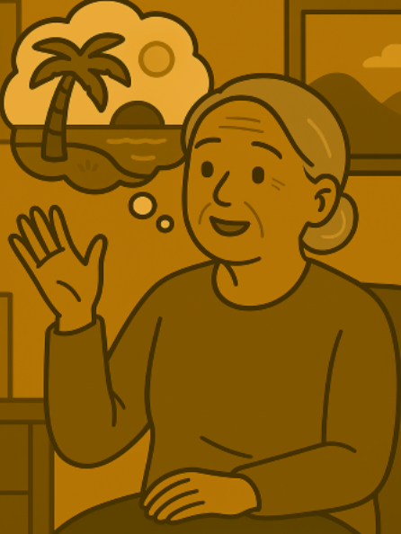
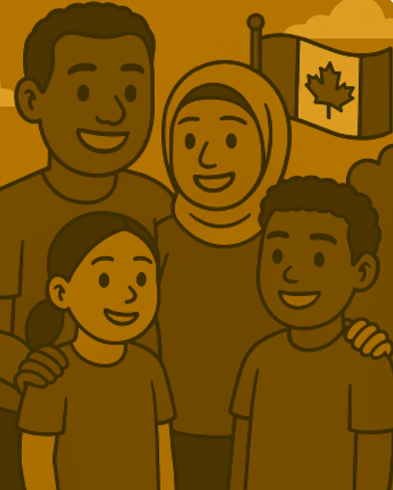
call
talk
live
He called his friend last week.
She talked about her vacation.
They lived in Canada for five years.
Notes:
.Call – he called his friend last week. Talk – She talked about her vacation. Live – they lived in Canada for five years.

Slide 5
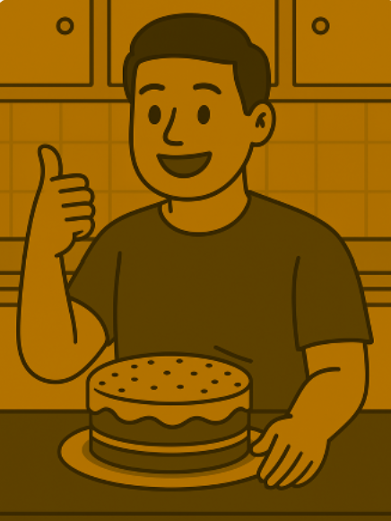
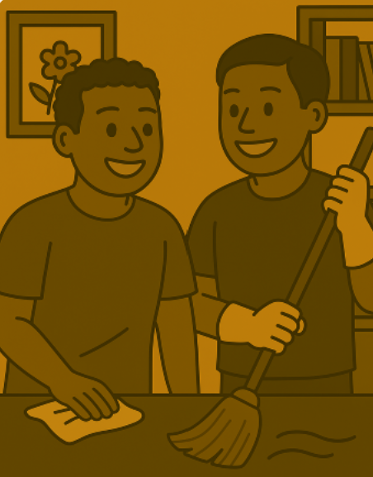
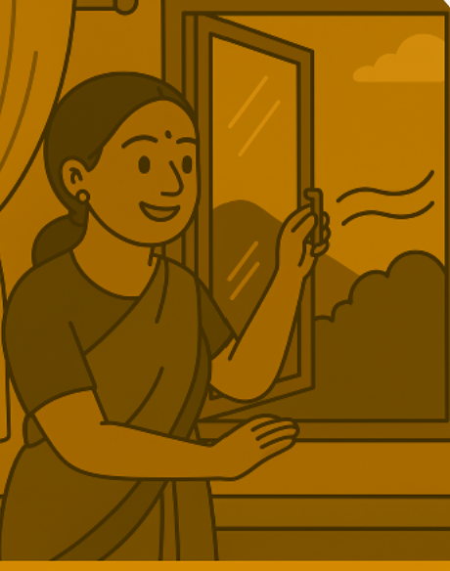
like
open
clean
He liked the cake.
I opened the window.
We cleaned the house last Saturday.
Notes:
Like – He liked the cake. Open – I opened the window. Clean – we cleaned the house last Saturday.

Slide 6
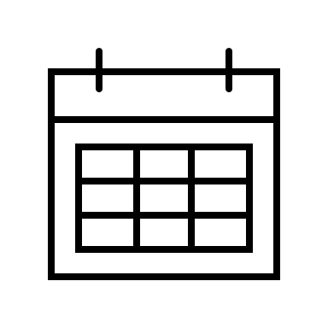
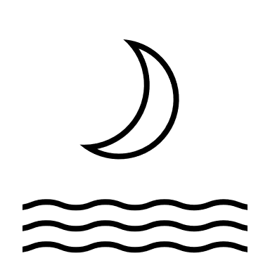
More Time Expressions
Yesterday
Last
Ago
yesterday morning
last night
five minutes ago
last week
two hours ago
yesterday afternoon
last month
six months ago
yesterday evening
last spring
last Tuesday
Notes:
As mentioned before, time expressions can help us know more exactly when in the past something happened. We have already seen some time expressions with yesterday. For example, yesterday morning or yesterday afternoon. And we can also use yesterday evening, And we have seen some time expressions with last. For example last night, last week. We can also use last month, last spring, or last Tuesday. And ‘ago’ is also used as a time expression. For example, 5 minutes ago, two hours ago, or 6 months ago. Time expressions are not used in every simple past sentence, but they do help us to be more specific about when something happened.

Slide 7
What did you do yesterday afternoon?
What did you do last week?
What did you do six months ago?
Simple Past – Regular Verbs Presentation © 2025 by Tiffany Kearns is licensed under CC BY-NC-SA 4.0.
To view a copy of this license, visit https://creativecommons.org/licenses/by-nc-sa/4.0/
Notes:
So, think about it, what did you do yesterday afternoon? What about last week? What did you do six months ago? Can you remember? Thanks for watching!

