Slide 1
Simple Past
Negative and Question Formation
Simple Past – Negative and Question Formation Presentation © 2025 by Tiffany Kearns is licensed under
CC BY-NC-SA 4.0.
To view a copy of this license, visit https://creativecommons.org/licenses/by-nc-sa/4.0/
Notes:
This video will review the negative and question forms for simple past

Slide 2
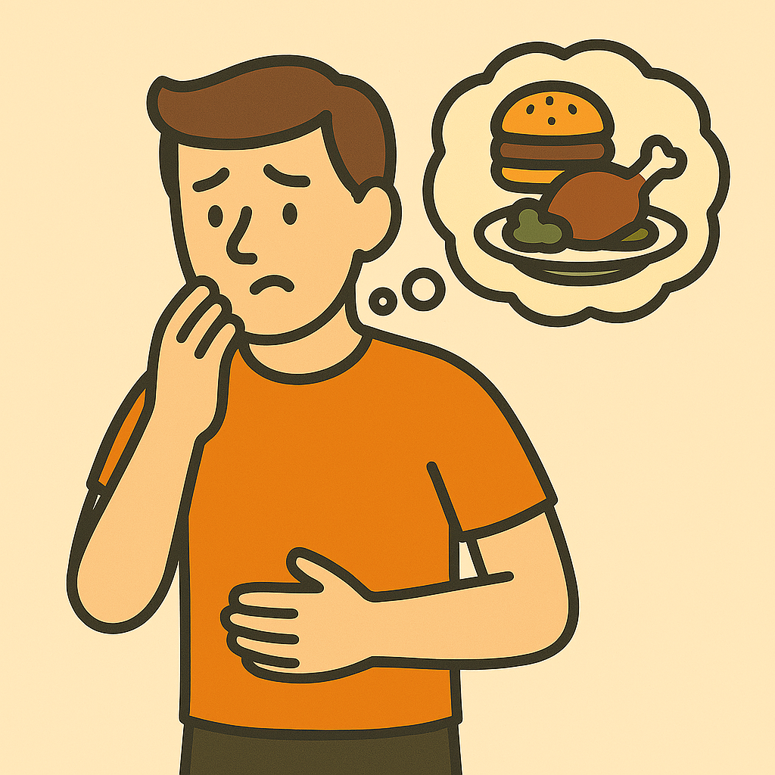
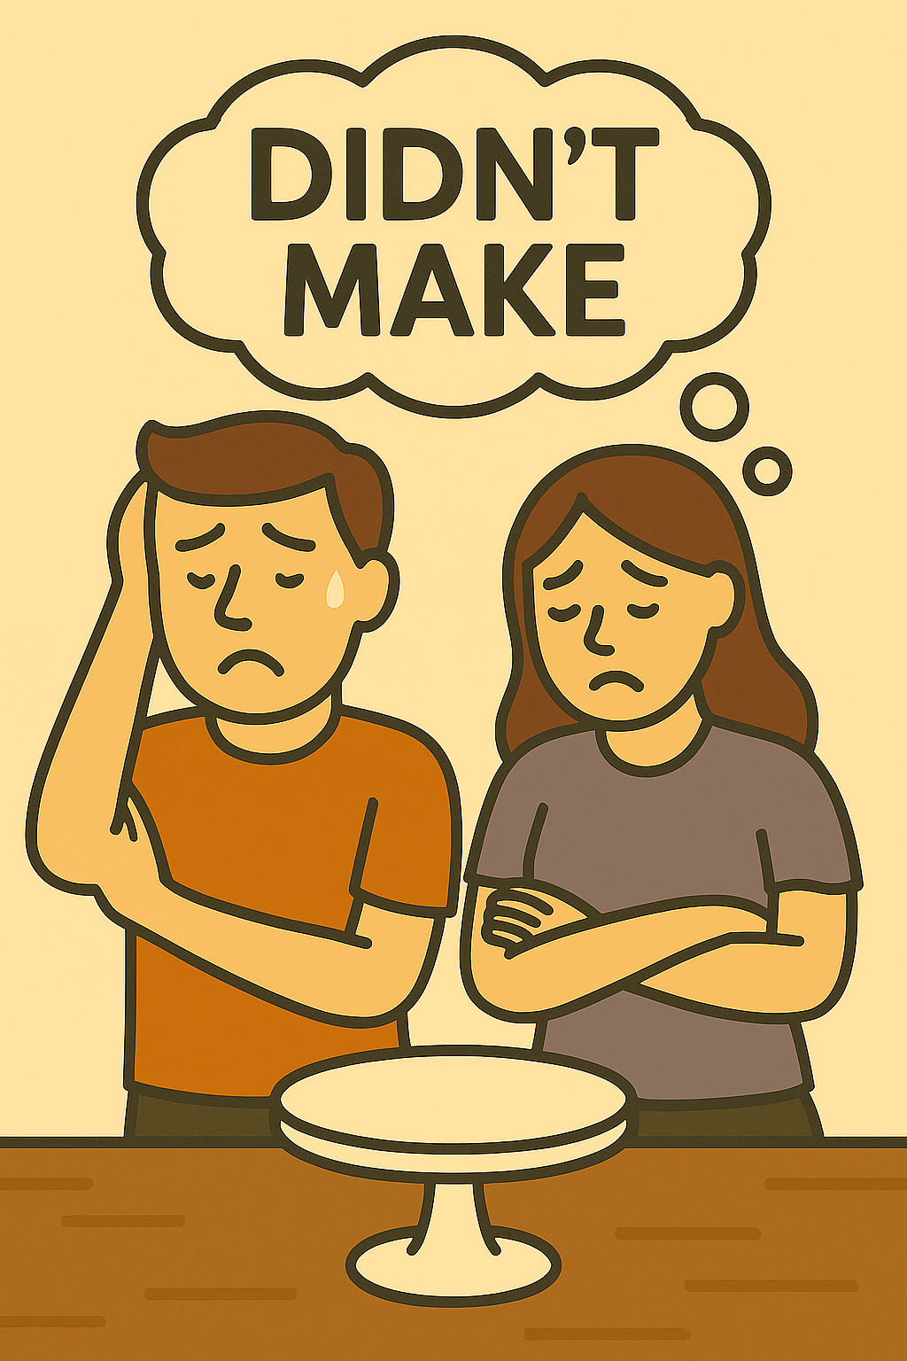
Regular
And
Irregular
Simple Past Negative
Subject
did not (didn’t)
main verb (base form)
I
didn’t
eat lunch.
He
didn’t
do homework.
We
didn’t
make a cake.
Notes:
-to form the negative with simple past regular -ed verbs and irregular verbs, we start with the subject, plus did not or (didn’t) and then the main verb in base form. For example, I didn’t eat lunch. He didn’t do homework. We didn’t make a cake.

Slide 3
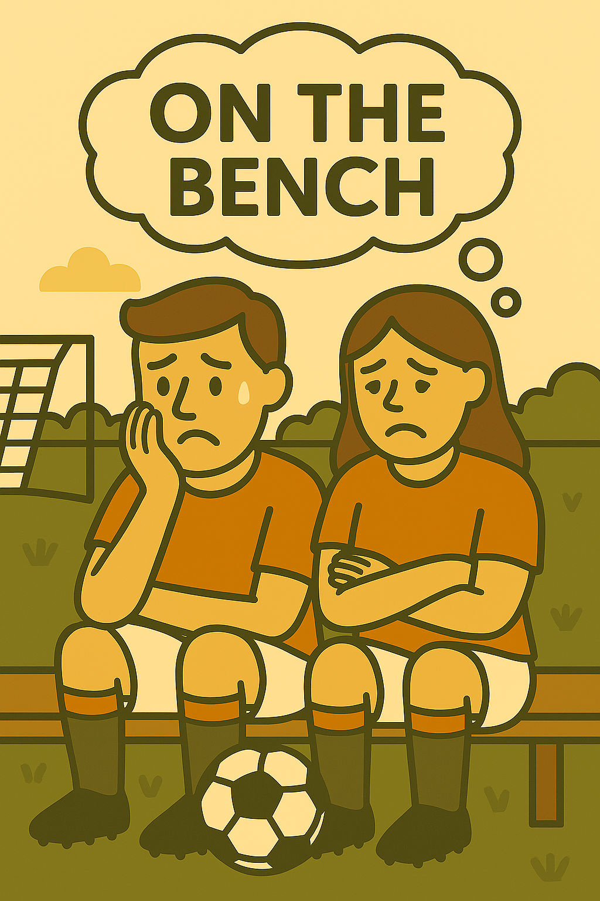
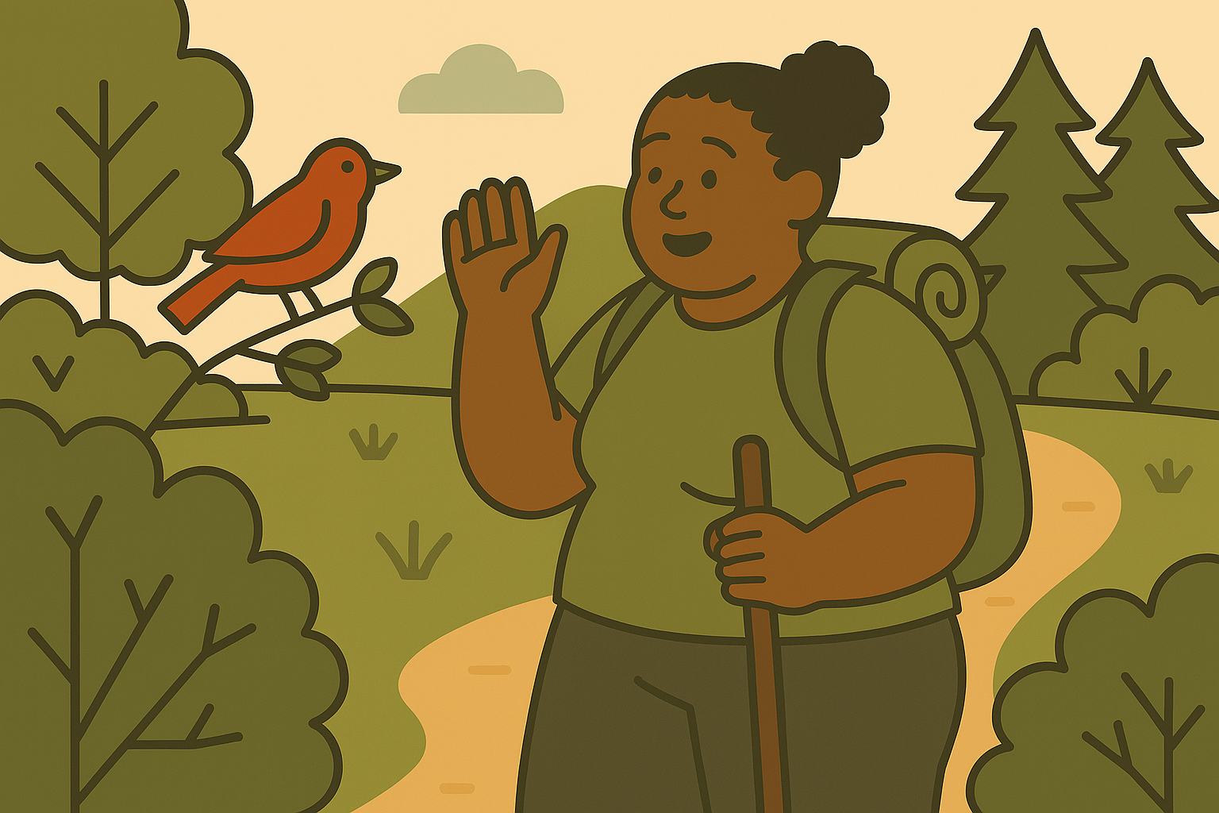
She didn’t see a bear. She saw a bird.
We didn’t work late. We left early.
They didn’t play soccer. They sat on the bench.
Notes:
Here are a few more: She didn’t see a bear. She saw a bird. We didn’t work late. We left early. They didn’t play soccer. They sat on the bench. Notice that when you make a negative sentence in simple past, didn’t is the word that shows we are talking about the past. The main verb is in base form. In positive sentences, the main verb shows the past form.

Slide 4
Simple Past Negative
subject
was/were not (wasn’t/weren’t)
She
wasn’t
at school yesterday.
She didn’t be at school yesterday.
Notes:
-One exception to this is with the verb ‘be’. With be we form the negative with its past form. For example: She was not or wasn’t at school yesterday. We do not say or write She didn’t be at school yesterday.

Slide 5
Yes/No Questions
Did
subject
main verb (base form)
No, she didn’t. She saw a bird.
Did
she
see a bear?
Yes, they did.
Did
they
leave early?
Notes:
-When we make yes/no questions in the simple past, we begin with the past form did plus the subject and then the main verb. For example, Did she see a bear? No, she didn’t. She saw a bird. Did they leave early? Yes, they did.

Slide 6
Information Questions
Question Word
did
subject
main verb (base form)
Where
did
you
have lunch?
I had lunch at home.
Notes:
-When we form information questions in the simple past, we begin with the question word plus did, then the subject, then the main verb in base form. For example: where did you have lunch? I had lunch at home. Notice that in the question the main verb is in base form. We know the question is asking about the past because did is in the past. In the answer, the main verb is back in simple past form

Slide 7
Information Questions
Question Word
did
subject
main verb (base form)
When
did
he
do homework?
He did homework yesterday.
Notes:
When did he do homework? He did homework yesterday. Again notice that the main verb in a simple past question is in base form. Did in the question shows us that it is past. In the answer, the main verb is back in simple past form.

Slide 8
Information Questions
Question Word
did
subject
main verb (base form)
Why
did
you
make a cake?
We made the cake for the birthday party.
Notes:
Why did you make a cake? We made a cake for the birthday party. Again, notice the verb forms.

Slide 9
What did and didn’t you do this past week?
Simple Past – Negative and Question Formation Presentation © 2025 by Tiffany Kearns is licensed under
CC BY-NC-SA 4.0.
To view a copy of this license, visit https://creativecommons.org/licenses/by-nc-sa/4.0/
Notes:
So, ask your friend what they did and didn’t do this past week. And don’t forget the question mark when you write! Thanks for watching!

