Slide 1
Simple Past
Irregular Verbs
Simple Past – Irregular Verbs Presentation © 2025 by Tiffany Kearns is licensed under CC BY-NC-SA 4.0.
To view a copy of this license, visit https://creativecommons.org/licenses/by-nc-sa/4.0/
Notes:
-This video will review some of the most common irregular verbs used with simple past tense

Slide 2
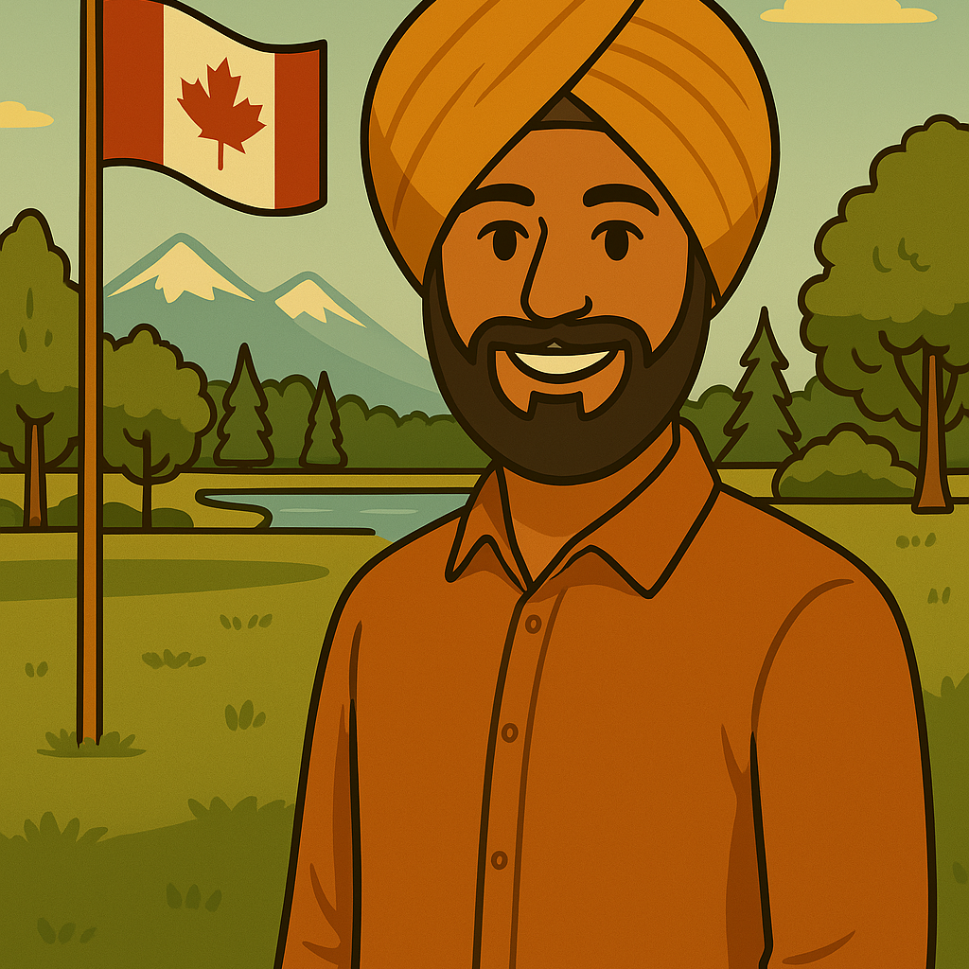
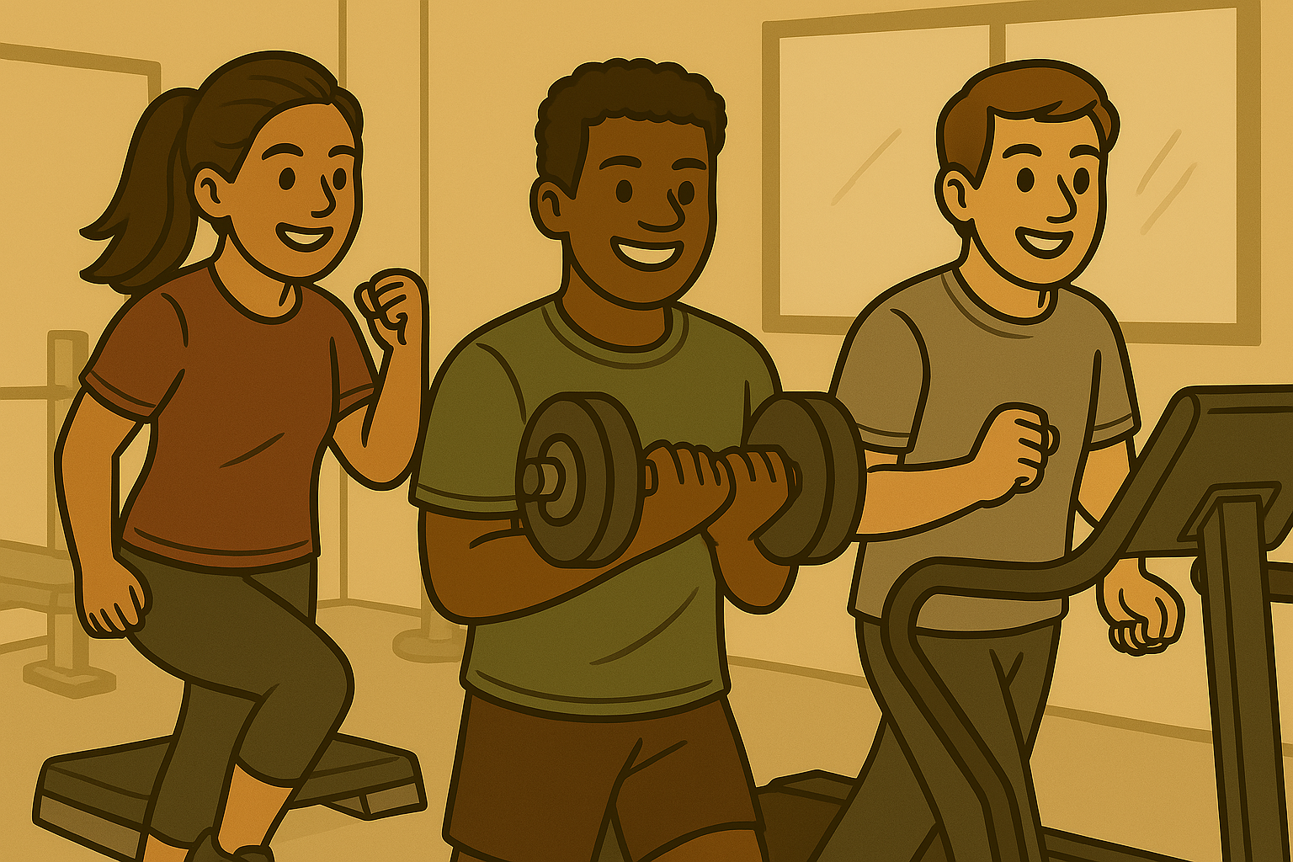
Simple Past with Irregular Verbs
Subject
irregular past form
I
was
at the park.
They
were
at the gym
Notes:
-We have already seen the verb be. The simple past form is was/were. For example: I was at the park. They were at the gym. Other irregular verbs follow the same pattern – subject plus irregular past form.

Slide 3
have - had
do - did
make - made
I had lunch an hour ago.
He did homework yesterday.
We made a cake.
Notes:
-Let’s have a look at a few more: Have-had – I had lunch an hour ago.
Do-did – he did homework yesterday.-sticker
Make-made – we made a cake.-sticker

Slide 4
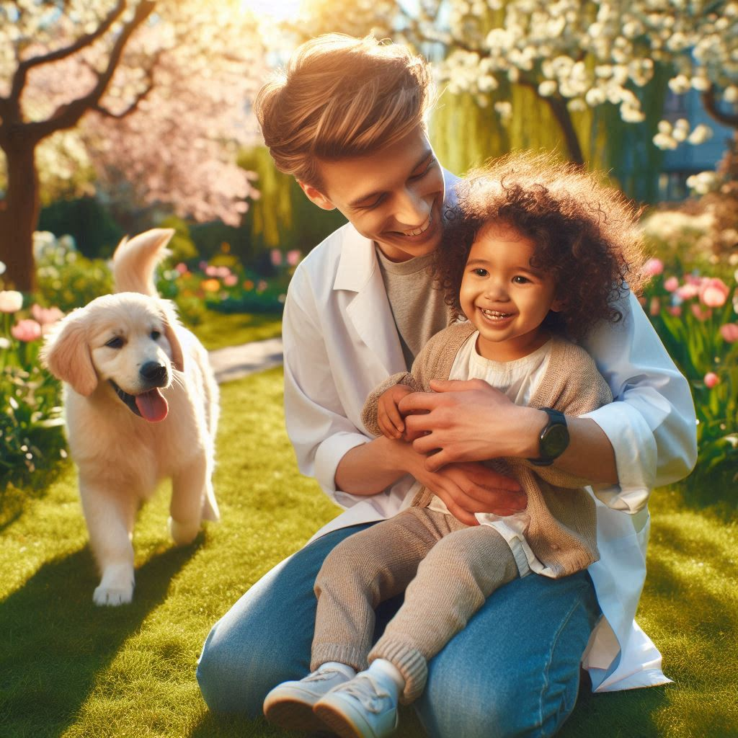
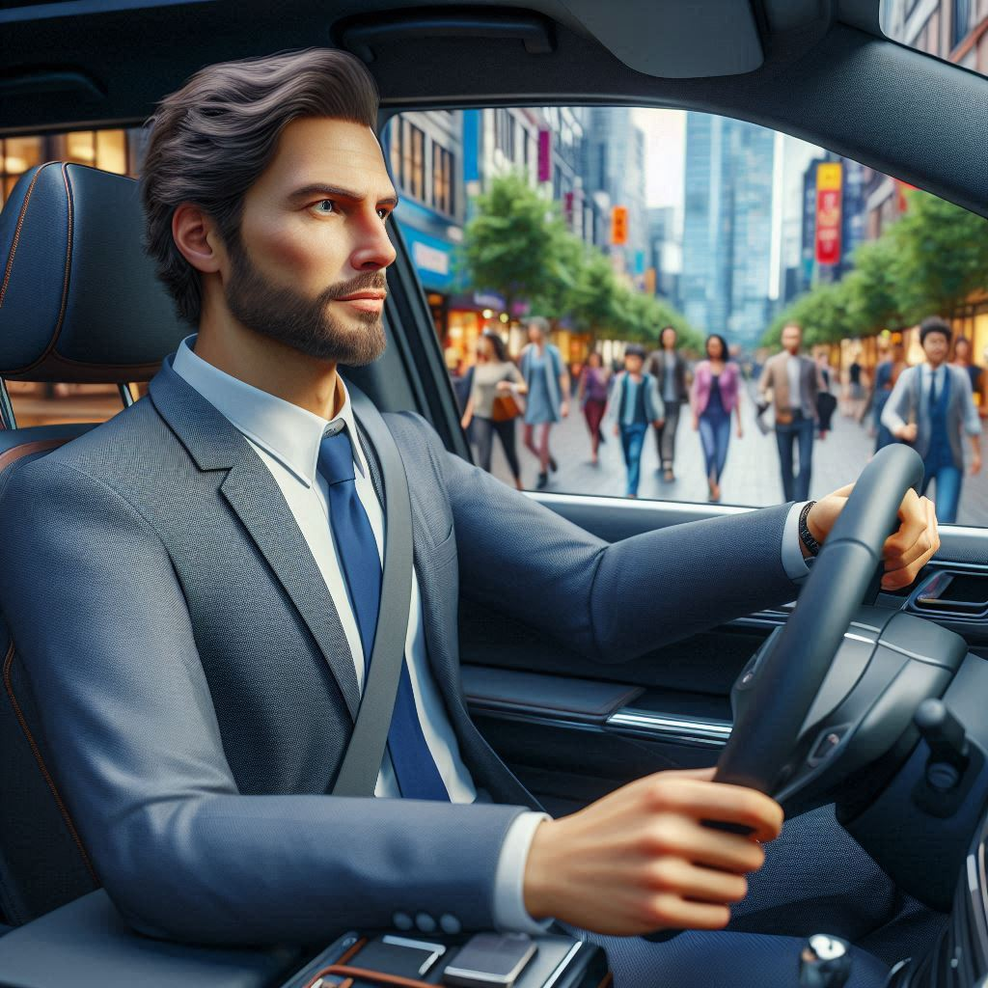
take - took
eat - ate
drive - drove
Lev took his daughter and dog to the park.
Natalia ate breakfast.
Ali drove to work two hours ago.
Notes:
Take – took – Lev took his daughter and dog to the park.
Eat-ate – Natalia ate breakfast.
Drive-drove – Ali drove to work two hours ago.

Slide 5
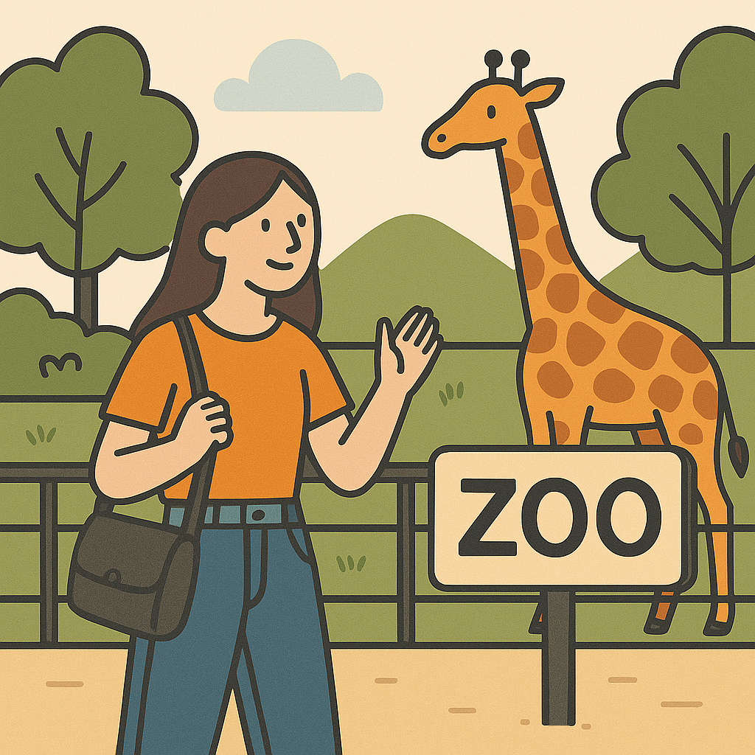
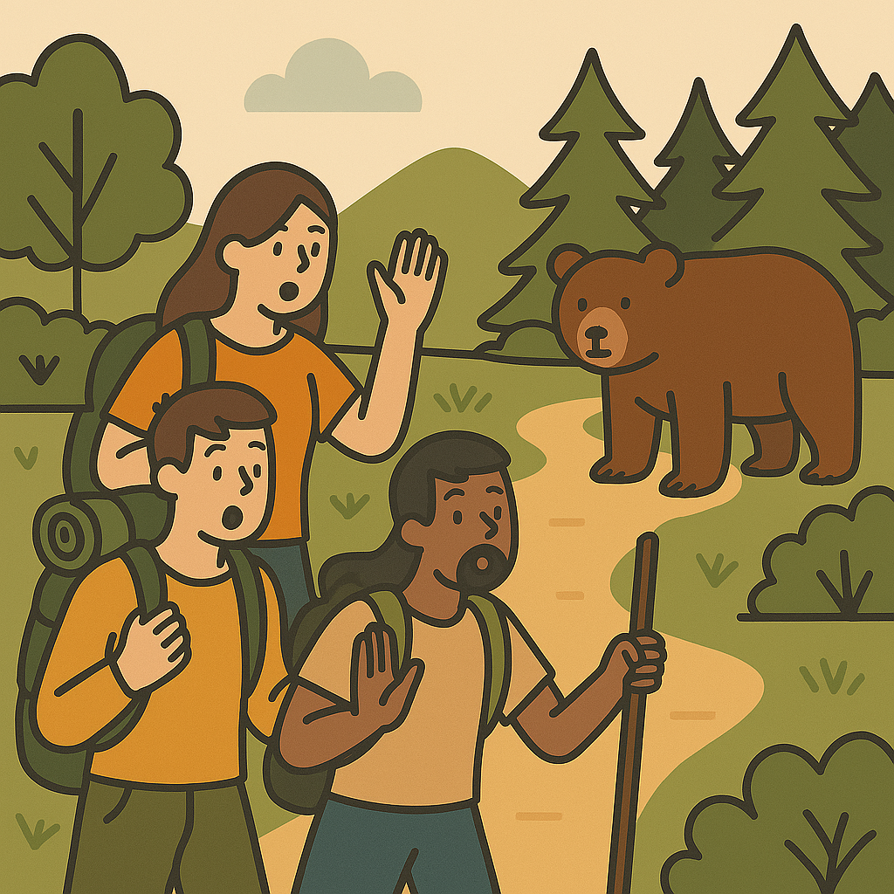
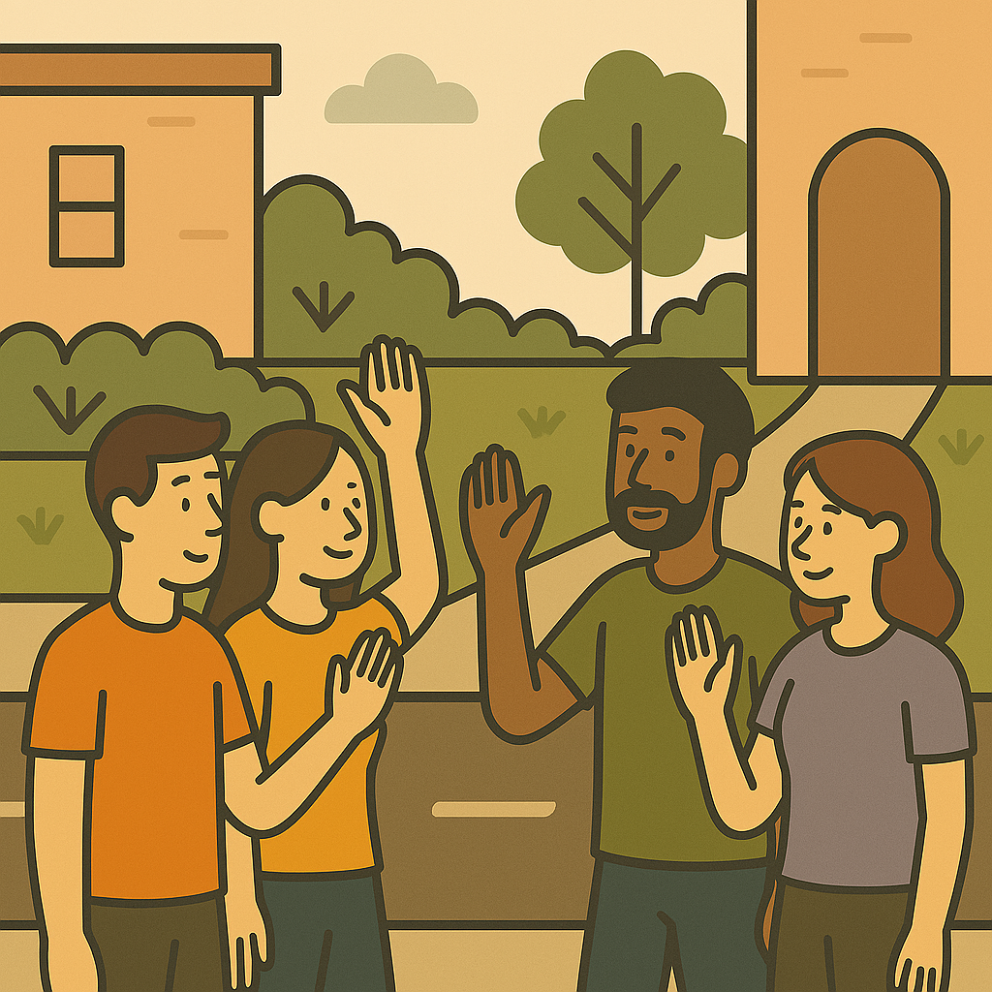
go - went
see - saw
say - said
She went to the zoo last weekend.
They saw a bear.
We said hello.
Notes:
Go-went – she went to the zoo last weekend.
See-saw – they saw a bear.
Say-said – We said hello.

Slide 6
When did you have lunch?
Did you do your homework?
Where did you drive?
Simple Past – Irregular Verbs Presentation © 2025 by Tiffany Kearns is licensed under CC BY-NC-ND 4.0.
To view a copy of this license, visit https://creativecommons.org/licenses/by-nc-nd/4.0/
Notes:
So, think about the last day, or week. When did you have lunch? Did you do your homework? Where did you drive? Thanks for watching!

