Slide 1
Simple Past
Be Verb and Time Expressions
Simple Past – Be Verb and Time Expressions Presentation © 2025 by Tiffany Kearns is licensed under
CC BY-NC-SA 4.0.
To view a copy of this license, visit https://creativecommons.org/licenses/by-nc-sa/4.0/
Notes:
This video will review the simple past form using the verb ‘be’ as well as time expressions.

Slide 2
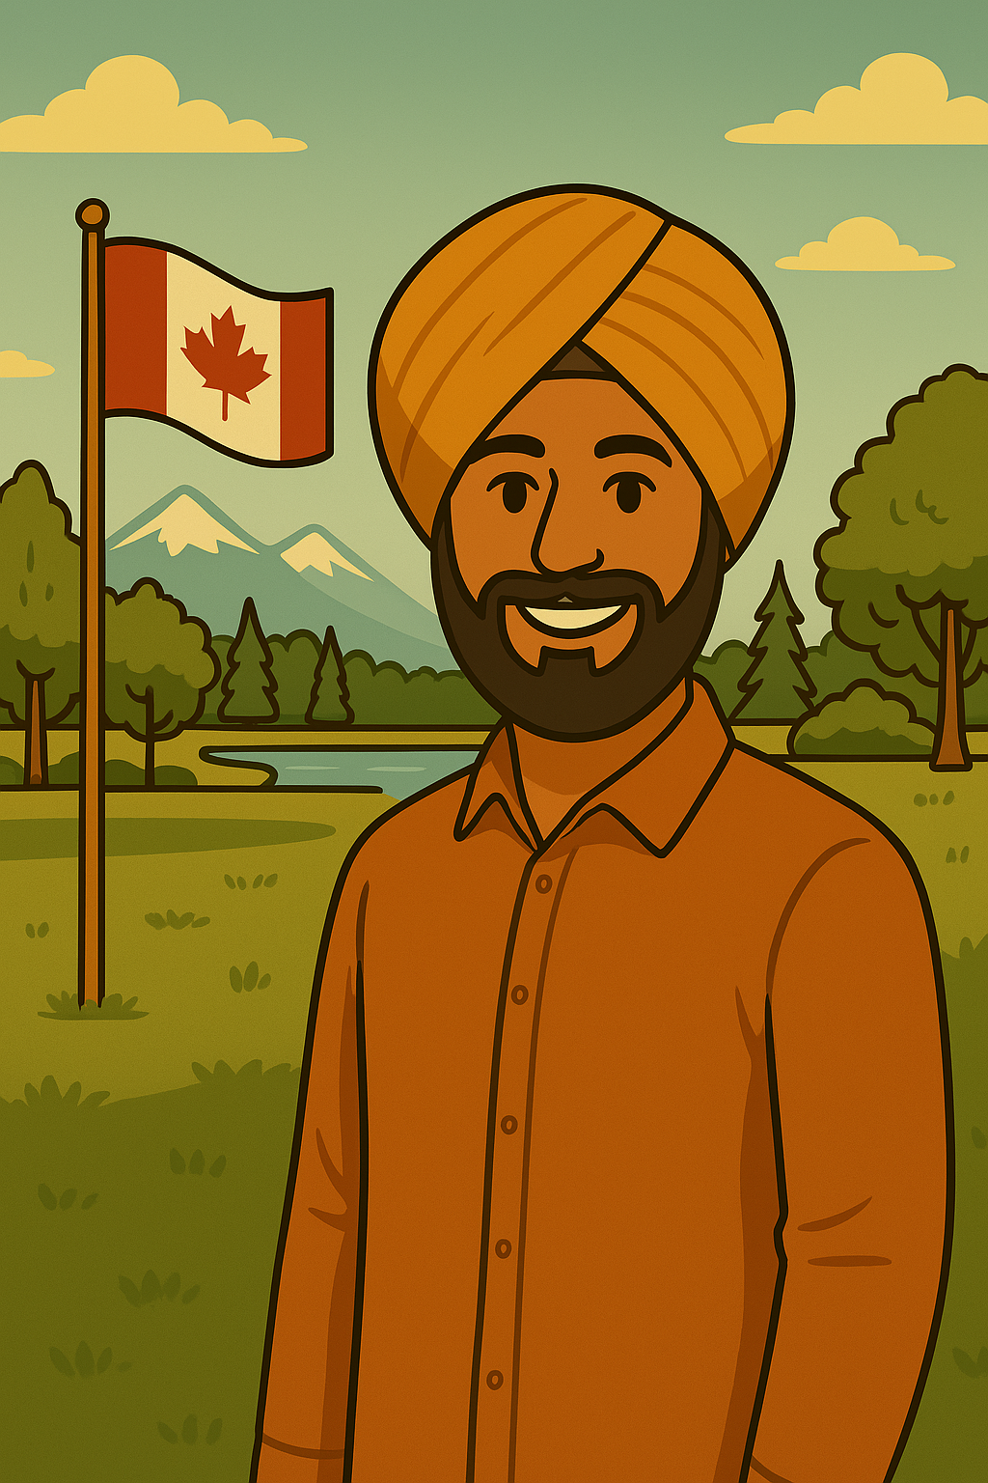
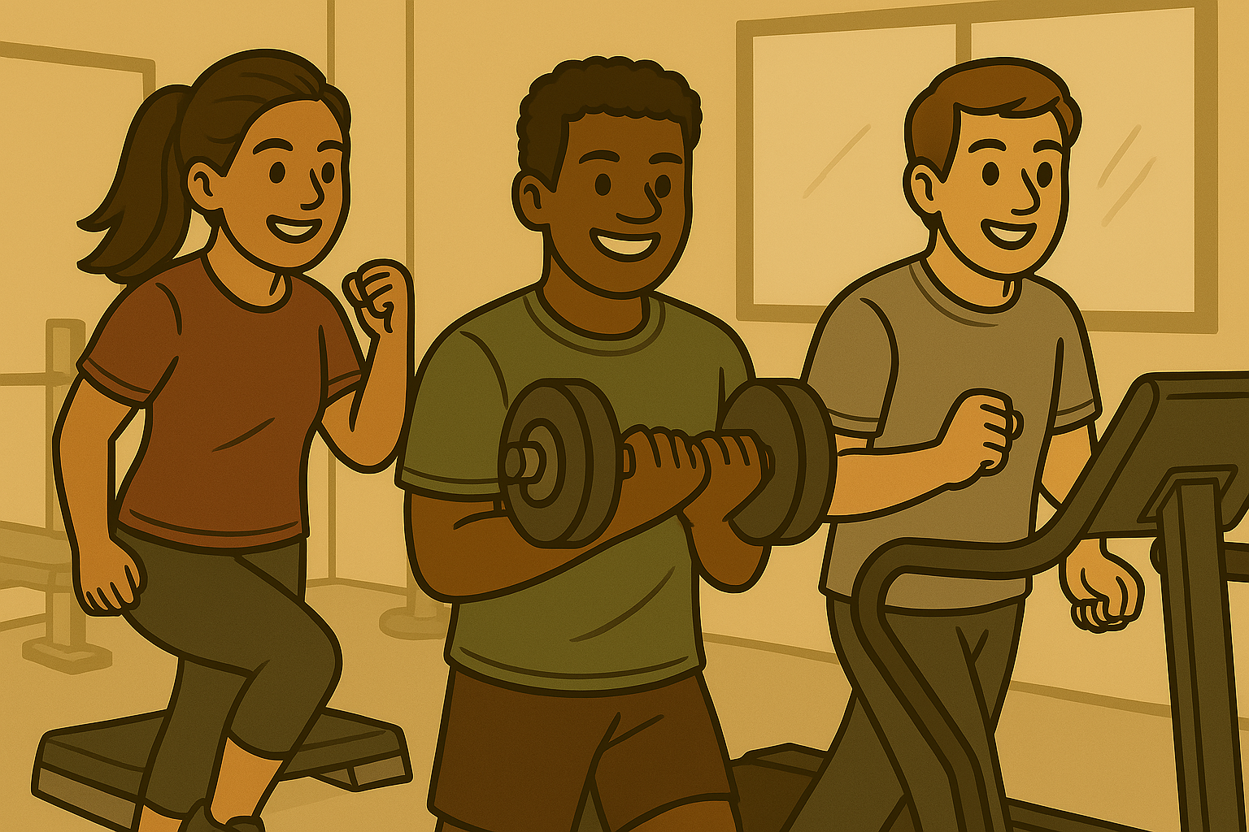
Verb Forms
I
she
he
it
was
I was at the park.
we
you
they
were
They were at the gym.
Notes:
The be verb is used in the simple past to talk about completed actions. The pronouns I, she, he, and it use the form ‘was’. The pronouns we, you, and they, use the form ‘were’. For example, I was at the park and They were at the gym.

Slide 3
Time Expressions
Present
Past
today ------------------------→
yesterday
this morning ---------------→
yesterday morning
this afternoon -------------→
yesterday afternoon
tonight ----------------------→
last night
this week -------------------→
last week
this month -----------------→
last month
Notes:
Some common time expressions used in the past include: yesterday, yesterday morning, yesterday afternoon, last night, last week, last month.

Slide 4
Yes/No Questions
Be (past form)
subject
Were
they
at the gym yesterday?
Yes, they were.
Or
No, they weren’t.
Was
Olena
at the coffee shop last night?
Yes, she was.
Or
No, she wasn’t.
Notes:
Yes/no questions follow the pattern be + subject, for example Were they at the gym yesterday? (yes, they were or no they weren’t ) Was Olena at the coffee shop last night? (yes she was, or no she wasn’t)

Slide 5
Information Questions
Question word
be
(past form)
subject
Where
were
you
yesterday?
I was at the park.
Notes:
Information questions are formed with the question word plus be in the past form plus the subject. For example: Where were you yesterday? I was at the park. Notice the time expression – yesterday. This tells us exactly when in the past we are asking about. And remember not to forget the question mark!

Slide 6
Information Questions
Question word
be
(past form)
subject
Where
was
Olena
last night?
She was at the coffee shop.
Notes:
Where was Olena last night? She was at the coffee shop. Again, notice the time expression – last night. Remember, this tells us exactly when in the past we are asking about. And remember the question mark!

Slide 7
Simple Past – Be Verb and Time Expressions Presentation © 2025 by Tiffany Kearns is licensed under CC BY-NC-ND 4.0.
To view a copy of this license, visit https://creativecommons.org/licenses/by-nc-nd/4.0/
Notes:
So, Were you at home yesterday? Or Were you at the park? Where were you? Thanks for watching!

