Slide 1
“ ”
Quotation Marks
Quotation Marks Presentation © 2025 by Kathini Dreilich is licensed under CC BY-NC-SA 4.0.
To view a copy of this license, visit https://creativecommons.org/licenses/by-nc-sa/4.0/
Notes:
Hi everybody. In this video on punctuation, we are going to look at quotation marks.

Slide 2
“ ”
“ ”
“ ”
Notes:
Quotation marks are made of two pairs of curved lines that look like hooks. Sometimes they look like the numbers 66 and 99, or they might be straighter. It just depends on the font that the author chose.

Slide 3
“Quotation marks come in pairs.”
“
”
Notes:
The pair of quotation marks on the left are the opening quotation marks, and the pair on the right are the closing quotation marks.[click] Both pairs curve towards the text.

Slide 4
Hello, said Mom.
“ ”
Notes:
Quotation marks let the reader know that a character in the story is talking. [click] They go at the top of the line of text. One pair comes at the beginning, when the character starts speaking, and the other pair comes at the end, when the character is finished talking.

Slide 5
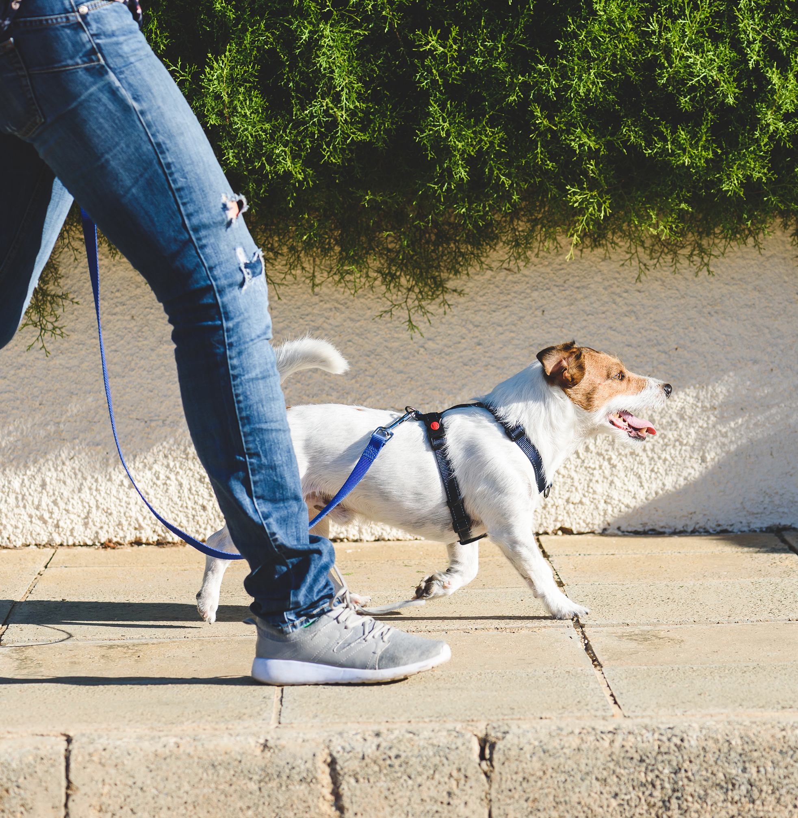
“Walk with me, Buddy,” said Sam.
said
Notes:
Authors will often use the word ‘said’ after the ending quotation marks and then they tell us who said that, like in this sentence that reads: “Walk with me, Buddy,” said Sam.

Slide 6
shouted
cried
asked
exclaimed
Notes:
There are other words that authors can use to show that someone is talking, [click] such as shouted, [click] cried, [click] asked, [click] exclaimed and many more.

Slide 7
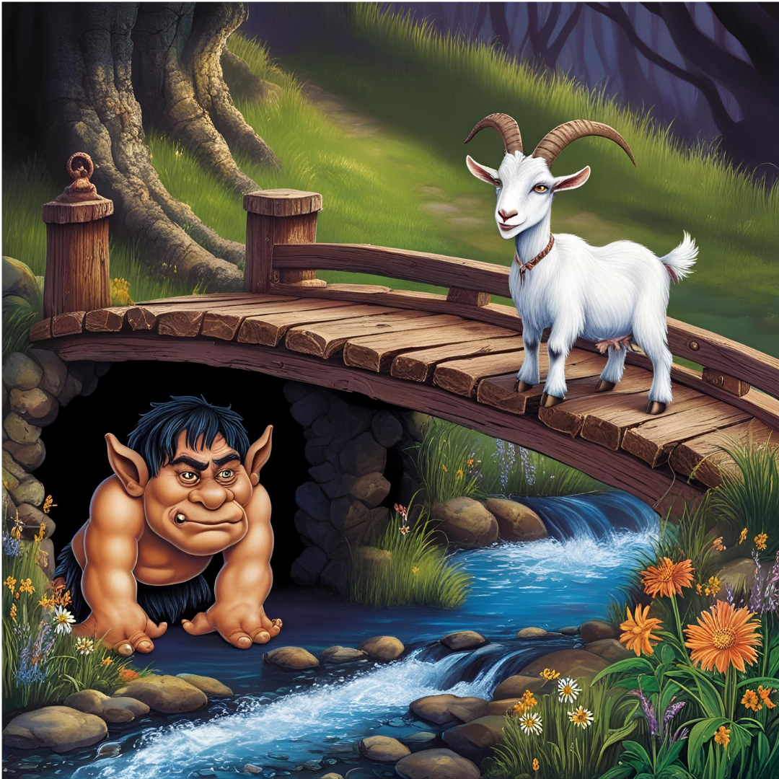
The smallest Billy Goat Gruff went across the bridge first.
“Who’s that trip-trapping over my bridge?” roared the troll.
“It is I, the littlest Billy Goat Gruff,” replied the goat.
“I’m going to eat you up!” the troll shouted.
Notes:
It can be fun to make your voice fit the character when you are reading out loud. [click] Quotation marks will show you which character is speaking so that you can change your voice. You will also know when the narrator is speaking. This example is from the classic story The Three Billy Goats Gruff. When I read it, I can change my voice between the narrator, the troll and the little billy goat Gruff, like this…

Slide 8
The smallest Billy Goat Gruff went across the bridge first.
“Who’s that trip-trapping over my bridge?” roared the troll.
“It is I, the littlest Billy Goat Gruff,” replied the goat.
“I’m going to eat you up!” the troll shouted.
Notes:
The smallest Billy Goat Gruff went across the bridge first. “Who’s that trip-trapping over my bridge?” roared the troll. “It is I, the littlest Billy Goat Gruff,” replied the goat. “I’m going to eat you up!” the troll shouted.

Slide 9
“Thank you for joining me to learn about quotation marks,” said the teacher.
Quotation Marks Presentation © 2025 by Kathini Dreilich is licensed under CC BY-NC-SA 4.0.
To view a copy of this license, visit https://creativecommons.org/licenses/by-nc-sa/4.0/
Notes:
Thank you for joining me to learn about quotation marks.

