Slide 1
Present
Continuous
Question Formation
Present Continuous Question Formation Presentation © 2025 by Tiffany is licensed under CC BY-NC-SA 4.0.
To view a copy of this license, visit https://creativecommons.org/licenses/by-nc-sa/4.0/
Notes:
This video will review present continuous question formation used when you want to know what actions someone is doing now.

Slide 2
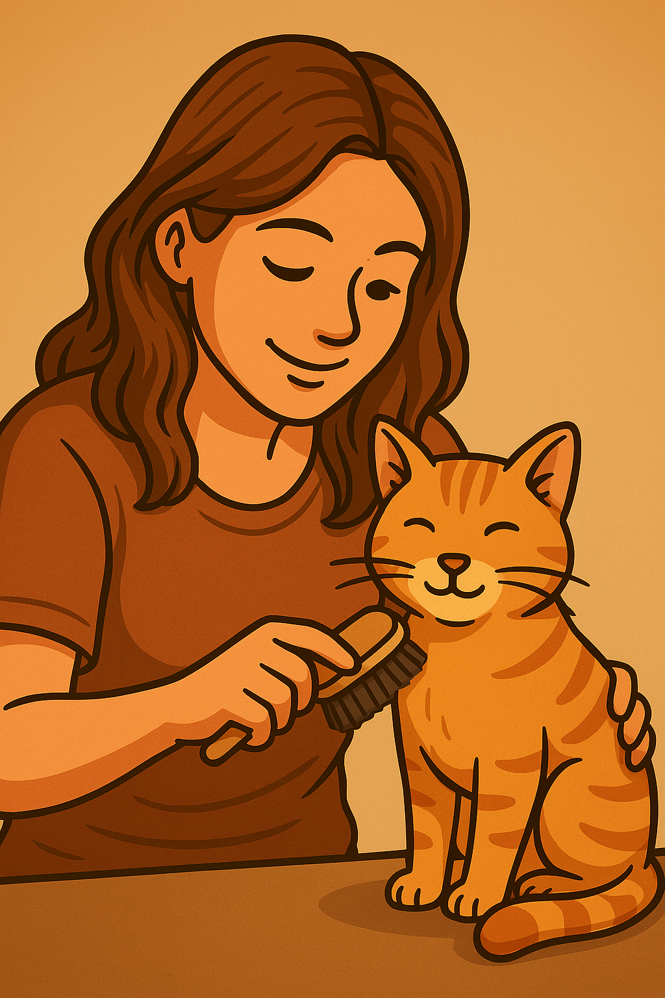
Yes/No Questions
Be verb
Subject
Main verb + -ing
Yes, she is.
or
No, she isn’t.
Is
Arem
working?
Are
they
playing video games?
Yes, they are.
or
No, they aren’t.
Notes:
To form Yes/No Questions with present continuous, start with the be verb plus the subject plus the main verb with -ing. Don’t forget a question mark at the end! For example: Is Arem working? Yes she is or no she isn’t. That’s right, she isn’t working. She is taking care of her cat. Are they playing video games? Yes, they are or no they aren’t. That’s right, they are playing video games!

Slide 3
Is Natalia brushing her teeth?
No, she isn’t.
She is eating breakfast.
Is Ali driving to work?
Yes, he is.
Is Elham going to bed?
No, he isn’t. He is doing chores.
Notes:
-Let’s try a few more: Is Natalia brushing her teeth? No, she isn’t. She is eating breakfast.
Is Ali driving to work? Yes, he is.
Is Elham going to bed? No, he isn’t. He is doing chores.

Slide 4
Information Questions
Question word
Be verb
Subject
Main verb + -ing
What
is
Mei
doing?
Where
is
Masi
sleeping?
She is eating because she is hungry.
She is brushing her teeth.
She is sleeping in her bed.
Why
is
Natalia
eating?
Notes:
Now let’s review information question form. Remember to start with the question word, be verb, then the subject and finally the main verb with -ing. For example: What is Mei doing? She is brushing her teeth. Where is Masi sleeping? She is sleeping in her bed. Why is Natalia eating ? She is eating because she is hungry.

Slide 5
What is Lev doing?
Where is Olena meeting her friend?
Why is Elham doing chores?
He is taking care of his daughter.
She is meeting her friend at a café.
He is doing chores because his house is dirty.
Notes:
Let’s try a few more: What is Lev doing? He is taking care of his daughter. Where is Olena meeting her friend? She is meeting her friend at a café. Why is Elham doing chores? He is doing chores because his house is dirty.

Slide 6
What are you studying?
Are you studying well?
Where are you studying?
Why are you studying?
Present Continuous Question Formation Presentation © 2025 by Tiffany Kearns is licensed under CC BY-NC-SA 4.0.
To view a copy of this license, visit https://creativecommons.org/licenses/by-nc-sa/4.0/
Notes:
So, think about it. What are you studying? Are you studying well? Where are you studying? And Why are you studying? Thanks for watching!

