Slide 1
Present
Continuous
For Actions Happening Now
Present Continuous For Actions Happening Now Presentation © 2025 by Tiffany Kearns is licensed under
CC BY-NC-SA 4.0.
To view a copy of this license, visit https://creativecommons.org/licenses/by-nc-sa/4.0/
Notes:
This video will review Present Continuous Tense used to talk about actions happening now.

Slide 2
Present Continuous
= Present Progressive
Subject
Be verb
Main verb + -ing
I
am
walking to the bus stop right now.
Ken
is
walking to the bus stop right now.
You
are
walking to the bus stop right now.
Notes:
-When we form the present continuous (sometimes also called present progressive), we use the helping verb ‘Be’ plus the base form of the main verb plus -ing.
--Let’s see some examples:
I am walking to the bus stop right now.
Ken is walking to the bus stop right now.
You are walking to the bus stop right now.

Slide 3
Ken
is
walking to the bus stop right now.
Notes:
-When I say that Ken is walking to the bus stop. It means that he is doing it right now and I am describing his action at the moment.

Slide 4
Daily Actions Happening
Now
Sofia is waking up.
Natalia is eating breakfast.
Mei is brushing her teeth.
Notes:
We can use Present continuous to describe daily actions if they are happening now. For example: Sofia is waking up. Natalia is eating breakfast. Mei is brushing her teeth.

Slide 5
Daily Actions Happening Now
Ali is driving to work.
Aaron is checking email.
Lev is taking care of his daughter.
Notes:
Ali is driving to work. Aaron is checking email. Lev is taking care of his daughter.

Slide 6
Daily Actions Happening Now
Elham is doing chores.
Olena is meeting a friend.
Masi is going to bed.
Notes:
Elham is doing chores. Olena is meeting a friend. And Masi is going to bed.

Slide 7
Present Continuous –
Negative Form
Subject
Be+not
Main verb + -ing
Sofia
is not
sleeping.
She is waking up.
Notes:
-We can also describe things we are ‘not’ doing. To form the negative of Present Continuous we use the helping verb ‘be’ plus not plus the -ing verb form.
For example: Sofia is not sleeping. She is waking up.

Slide 8
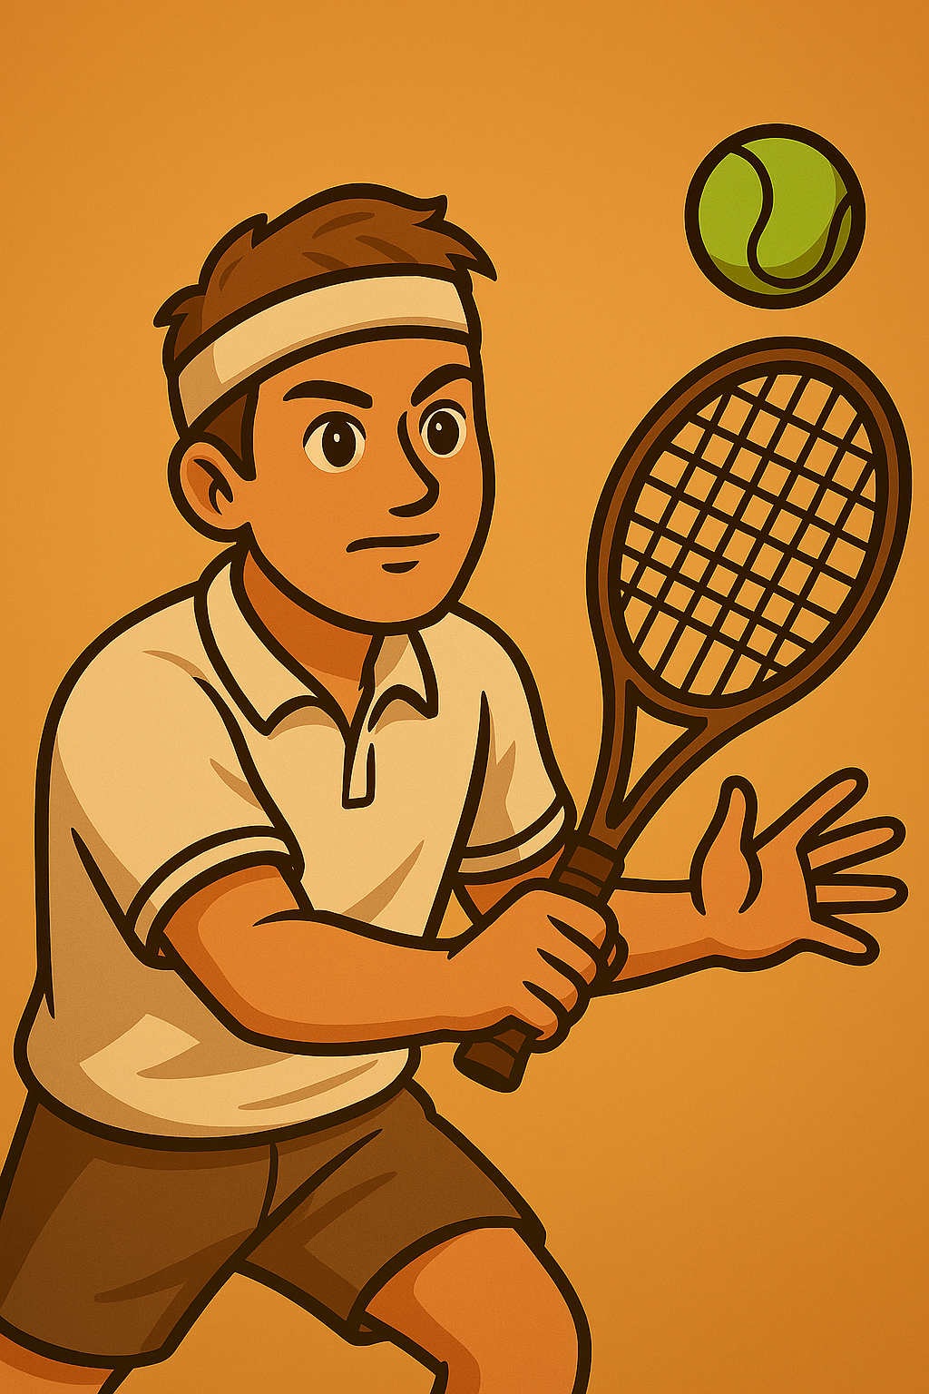
I am not studying.
I am playing tennis.
You are not cleaning.
You are watching a video and learning about present continuous.
Notes:
Let’s see more examples:
I am not studying. I am playing tennis.
You are not cleaning. You are watching a video and learning about present continuous tense.

Slide 9
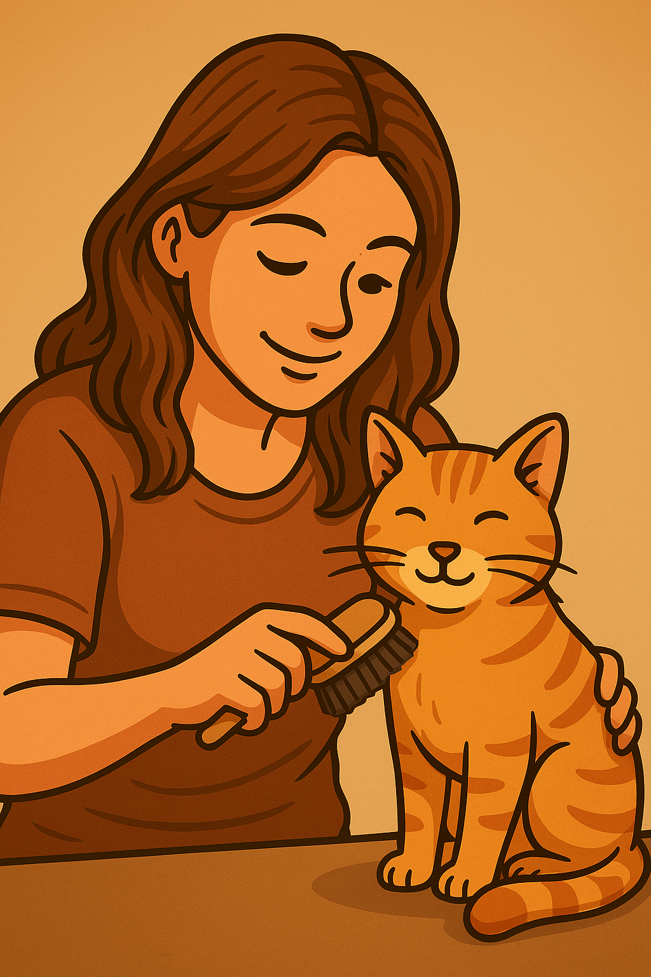
Arem is not working.
She is taking care of her cat.
They are not watching a movie.
They are playing video games.
Notes:
Arem is not working. She is taking care of her cat.
They are not watching a movie. They are playing video games.

Slide 10
are not = aren’t
is not = isn’t
You aren’t cleaning.
Arem isn’t working.
They aren’t watching a movie.
Notes:
It is common to use the contracted form of be and not for second and third person singular and plural, so You aren’t cleaning, Arem isn’t working and they aren’t watching a movie.

Slide 11
What are you doing right now?
What aren’t you doing right now?
Present Continuous For Actions Happening Now Presentation © 2025 by Tiffany Kearns is licensed under
CC BY-NC-SA 4.0.
To view a copy of this license, visit https://creativecommons.org/licenses/by-nc-sa/4.0/
Notes:
So, what are you doing right now? And what aren't you doing right now? Thanks for watching!

