Slide 1
’
Possessive Apostrophe
Possessive Apostrophe Presentation © 2025 by Kathini Dreilich is licensed under CC BY-NC-SA 4.0.
To view a copy of this license, visit https://creativecommons.org/licenses/by-nc-sa/4.0/
Notes:
Hi everybody. In this video on punctuation, we are going to look at how apostrophes can be used to show possession.

Slide 2
dog
dogs
Notes:
Often, the letter ‘s’ comes at the end of a word to make the word plural – this means that there’s more than one. For example, we would say “dog” [click] if there is just one, [click] or dogs [click] if there are two or more.

Slide 3
The dog’s bowl.
The dog’s house.
Notes:
If we want to talk about something that belongs to one dog, we can add an apostrophe and then an s after the word ‘dog,’ like this: [click] “The dog’s bowl.” and [click] “The dog’s house.” This is called a possessive apostrophe.

Slide 4
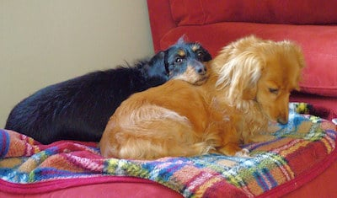
This is the dogs’ blanket.
Notes:
Sometimes something belongs to more than one person or animal. These dogs are sharing a blanket, so we would say: [click] “This is the dogs’ blanket.” [click] Notice that the apostrophe comes after the ‘s’ this time.

Slide 5
I like Charles’s haircut.
I like Charles’ haircut.
Notes:
Sometimes names or other words end in an ‘s’ when there is just one. For example, the name “Charles” ends in an ‘s’ but “Charles” is just one person. If I wanted to say that I like his haircut, there are two ways that the apostrophe can be used. I could say [click] “I like Charles’s haircut.” by adding [click] an apostrophe and then another ‘s. Or, I could say [click] “I like Charles’ haircut.” and add [click] an apostrophe after the ‘s’ that is already in his name.

Slide 6
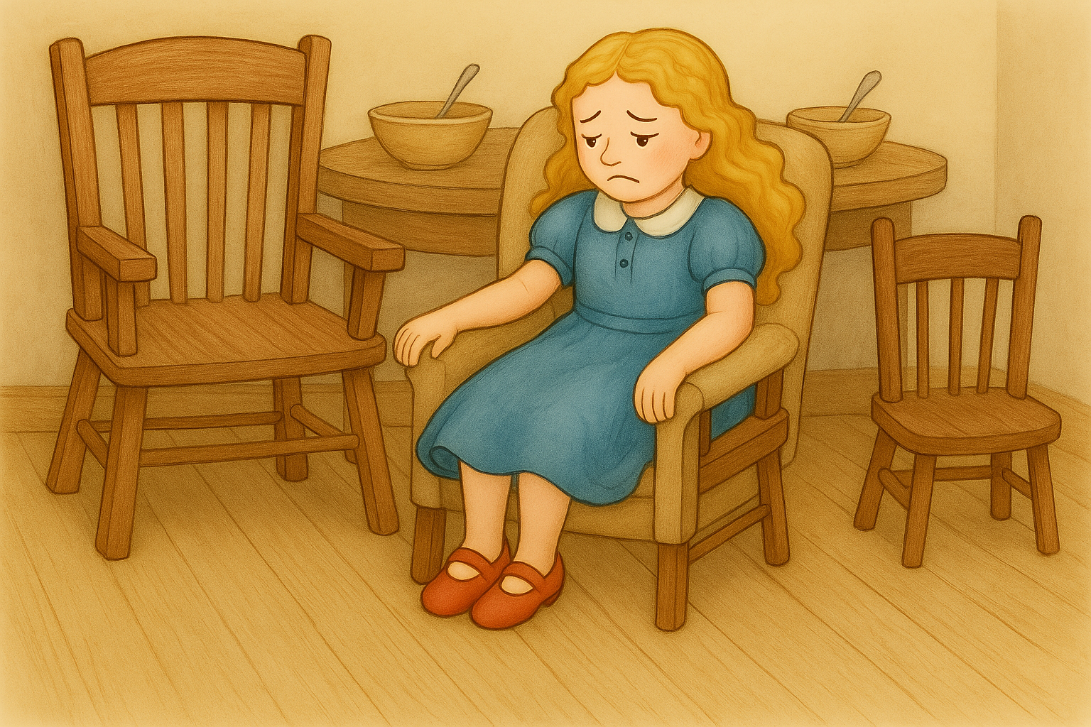
Goldilocks saw the three bears’ chairs.
She sat on Father Bear’s chair, but it was too hard.
She sat on Mother Bear’s chair, but it was too soft.
Next, she sat on Baby Bear’s chair, and it was just right!
Notes:
In the story “Goldilocks and the Three Bears,” Goldilocks is a little girl who goes in the bears’ house when they are out. [click]Here is part of the story [click]that includes possessive apostrophes.

Slide 7
Goldilocks saw the three bears’ chairs.
She sat on Father Bear’s chair, but it was too hard.
She sat on Mother Bear’s chair, but it was too soft.
Next, she sat on Baby Bear’s chair, and it was just right!
Notes:
Here is how this story sounds: “Goldilocks saw the three bears’ chairs. [click] She sat on Father Bear’s chair, but it was too hard. [click] She sat on Mother Bear’s chair, but it was too soft. [click] Next, she sat on Baby Bear’s chair, and it was just right!

Slide 8
Thank you for watching this teacher’s video on possessive apostrophes.
Possessive Apostrophe Presentation © 2025 by Kathini Dreilich is licensed under CC BY-NC-SA 4.0.
To view a copy of this license, visit https://creativecommons.org/licenses/by-nc-sa/4.0/
Notes:
Thank you for watching this teacher’s video on possessive apostrophes.

