Slide 1
Future Tense
Will
Future Tense With Will Presentation © 2025 by Tiffany Kearns is licensed under CC BY-NC-SA 4.0.
To view a copy of this license, visit https://creativecommons.org/licenses/by-nc-sa/4.0/
Notes:
This video will review how to form the future tense with will.

Slide 2
Future With Will
Subject
will
main verb (base form)
She
will
work late.
She wills work late.
She will works late.
Notes:
-to express the future we can also use the form will. Start with the subject plus will and then the base form of the main verb. For example, She will work late. Notice that there is no ‘s’ on will. It is incorrect to write She wills work late. Also, there is no ‘s’ on the main verb work– it is incorrect to write She will works late.

Slide 3
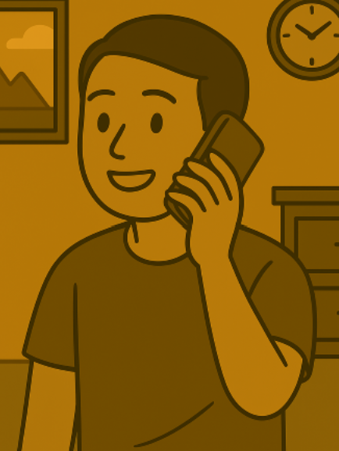
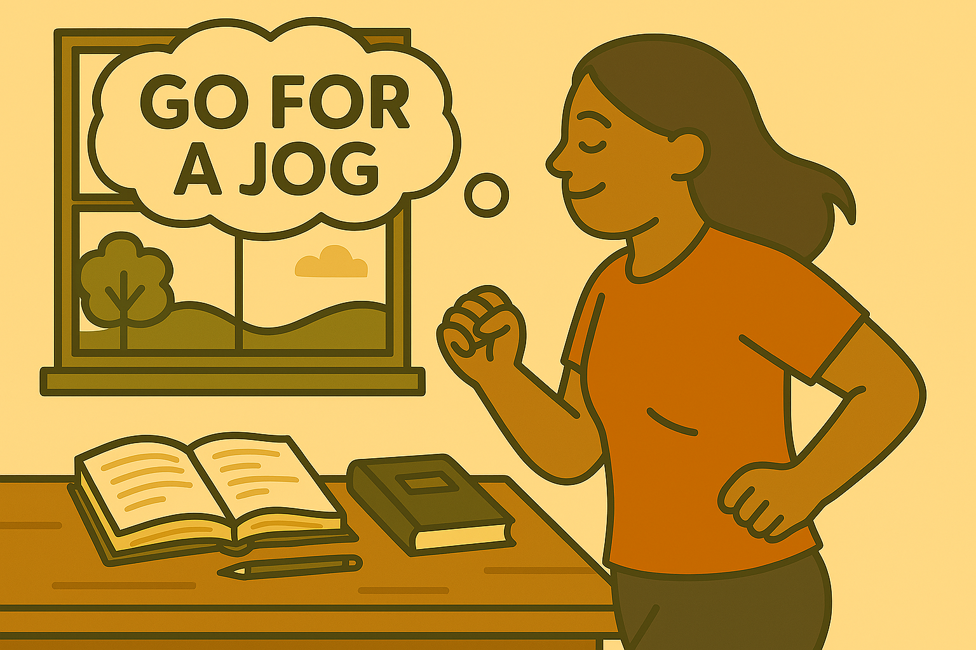
Contraction
Subject pronoun
will
’
wi
ll
I
call a friend.
She’ll go for a jog this afternoon.
They’ll play soccer next week.
Notes:
-it is common to contract the subject pronoun and will in both informal writing and speaking. Let’s see a few examples. I’ll call a friend. She’ll go for a jog this afternoon. They’ll play soccer next week. Notice the contracted subject pronouns and will. Also notice the base form of the main verb.

Slide 4
Negative
main verb
(base form)
Subject
will + not
We
will not
stay
late at work.
I
will not
go
to class today.
I will stay home because I am sick.
Notes:
-For the negative, we begin with the subject then will not and then the base form of the main verb. For example: We will not stay late at work. I will not go to class today. I will stay home because I am sick.

Slide 5
Contraction
will not ----------→ won’t
They won’t take the bus.
She won’t finish her work on time.
They’ll drive instead.
She’ll hand in her report late.
Notes:
-it is also common to contract will and not to make won’t. They won’t take the bus. They’ll drive instead. She won’t finish her work on time. She’ll hand in her report late.

Slide 6
Yes/No Questions
main verb (base form)
Will
Subject
Will
Liyu
go
to the library tomorrow?
Yes, he will.
Or
No, he won’t.
Yes, he’ll.
Notes:
-To form yes/no questions with will, begin with will then the subject then the main verb in base form. Will Liyu go to the library tomorrow? Yes, he will or No, he won’t. Note here that we do not contract will and the pronoun in a short answer. We cannot say or write Yes, he’ll.click. We must say click he will.

Slide 7
Information Questions
main verb (base form)
Question word
will
subject
When
will
Liyu
go
to the library?
He will go tomorrow morning.
He’ll go tomorrow morning.
Notes:
-For information questions we begin with the question word then will, then the subject and then the main verb. When will Liyu go to the library? He will go tomorrow morning. In this longer answer it is ok to contract, so we can also say He’ll go tomorrow morning.

Slide 8
What will you do tomorrow morning?
Will you go to the library and continue your study of basic tenses?
Future Tense With Will Presentation © 2025 by Tiffany Kearns is licensed under CC BY-NC-SA 4.0.
To view a copy of this license, visit https://creativecommons.org/licenses/by-nc-sa/4.0/
Notes:
-So, What will you do tomorrow morning? Will you go to the library and continue your study of basic tenses? Thanks for watching!

