Slide 1
Future Tense
Be Going To
Future Tense With Be Going To Presentation © 2025 by Tiffany Kearns is licensed under CC BY-NC-SA 4.0.
To view a copy of this license, visit https://creativecommons.org/licenses/by-nc-sa/4.0/
Notes:
This video will review how to form the future tense with ‘be going to’

Slide 2
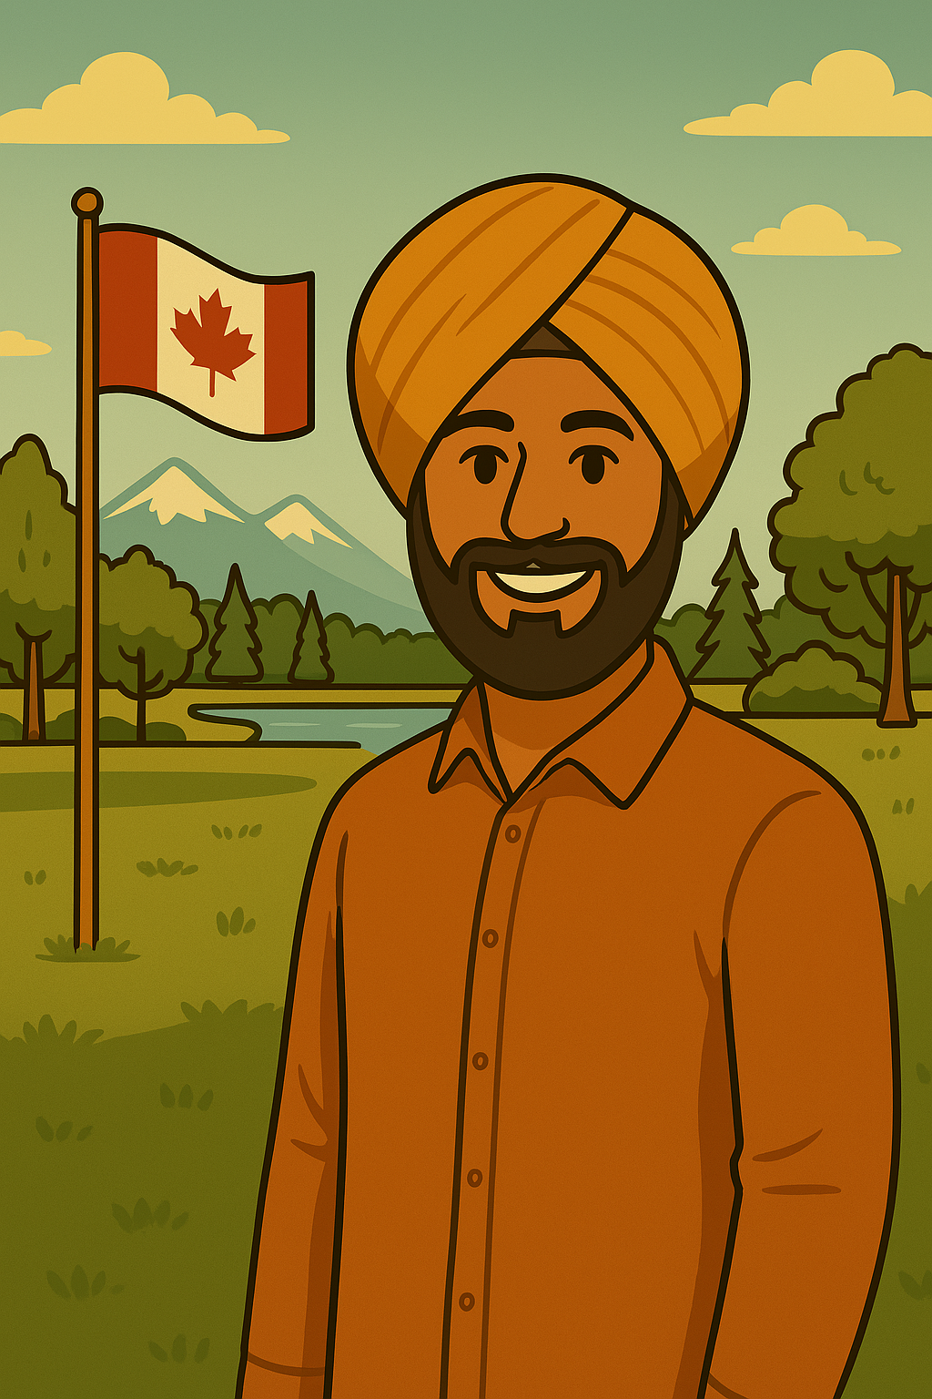
Future With Be Going To
(Infinitive)
Subject
be verb
going
to + base form
I
am
going
to go
to the park.
Natalia
is
going
to eat
breakfast.
We
are
going
to make
a cake.
Notes:
To express future meaning, we can use the form ‘be going to’. Start with the subject plus its form of the verb ‘be’ plus going and then the infinitive. Remember infinitive is to plus the base form of the verb. For example: I am going to go to the park. Natalia is going to eat breakfast. We are going to make a cake. Notice that there is subject/verb agreement between the subject of the sentence and the be verb.

Slide 3
Negative
(Infinitive)
Subject
be verb + not
going
to + base form
I
am not
going
to go
to school.
They
are not
going
to work
late.
She
is not
going
to study.
Notes:
To form the negative, start again with the subject, then use ‘be’ plus not, plus going and then the infinitive with to
For example: I am not going to go to school. They are not going to work late. She is not going to study. Again, notice that there is subject/verb agreement between the subject of the sentence and the be verb.

Slide 4
Yes/No Questions
(Infinitive)
Be verb
subject
going
to + base form
Am
I
going
to finish
on time?
Are
we
going
to drive?
Is
he
going
to go
to the library?
Notes:
For yes/no questions, put ‘be’ first, then the subject, then going then the infinitive. For example: Am I going to finish on time? Are we going to drive? Is he going to go to the library? Just like before, notice that there is subject/verb agreement between the subject of the sentence and the be verb even though the be verb comes first this time. Also, don’t forget those question marks?

Slide 5
Information Questions
Where is Ali going to go?
Why is Elham going to clean his house?
What time is Natalia going to meet her friend?
He is going to go to work.
He is going to clean his house because it is dirty.
She is going to meet her friend at six o’clock.
Notes:
And for information questions, don’t forget to begin with that question word, the rest follows the same pattern.
Where is Ali going to go? He is going to go to work.
Why is Elham going to clean his house? He is going to clean his house because it is dirty.
What time is Natalia going to meet her friend? She is going to meet her friend at 6 o’clock.

Slide 6
Future Time Expressions
Past | Future
yesterday | tomorrow
yesterday morning | tomorrow morning
yesterday afternoon | tomorrow afternoon
yesterday evening | tomorrow evening
last night | tomorrow night
Notes:
Don’t forget the future time expressions. Just like with past, there are expressions we can use for future too. One common one is tomorrow-click
tomorrow morning
Tomorrow afternoon
tomorrow evening
tomorrow night

Slide 7
Future Time Expressions
Past | Future
last week | next week
last year | next year
last summer | next summer
last Monday | next Monday
Notes:
Another common one is next
Last week---next week
Last year---next year
Last summer---next summer
Last Monday ---next Monday

Slide 8
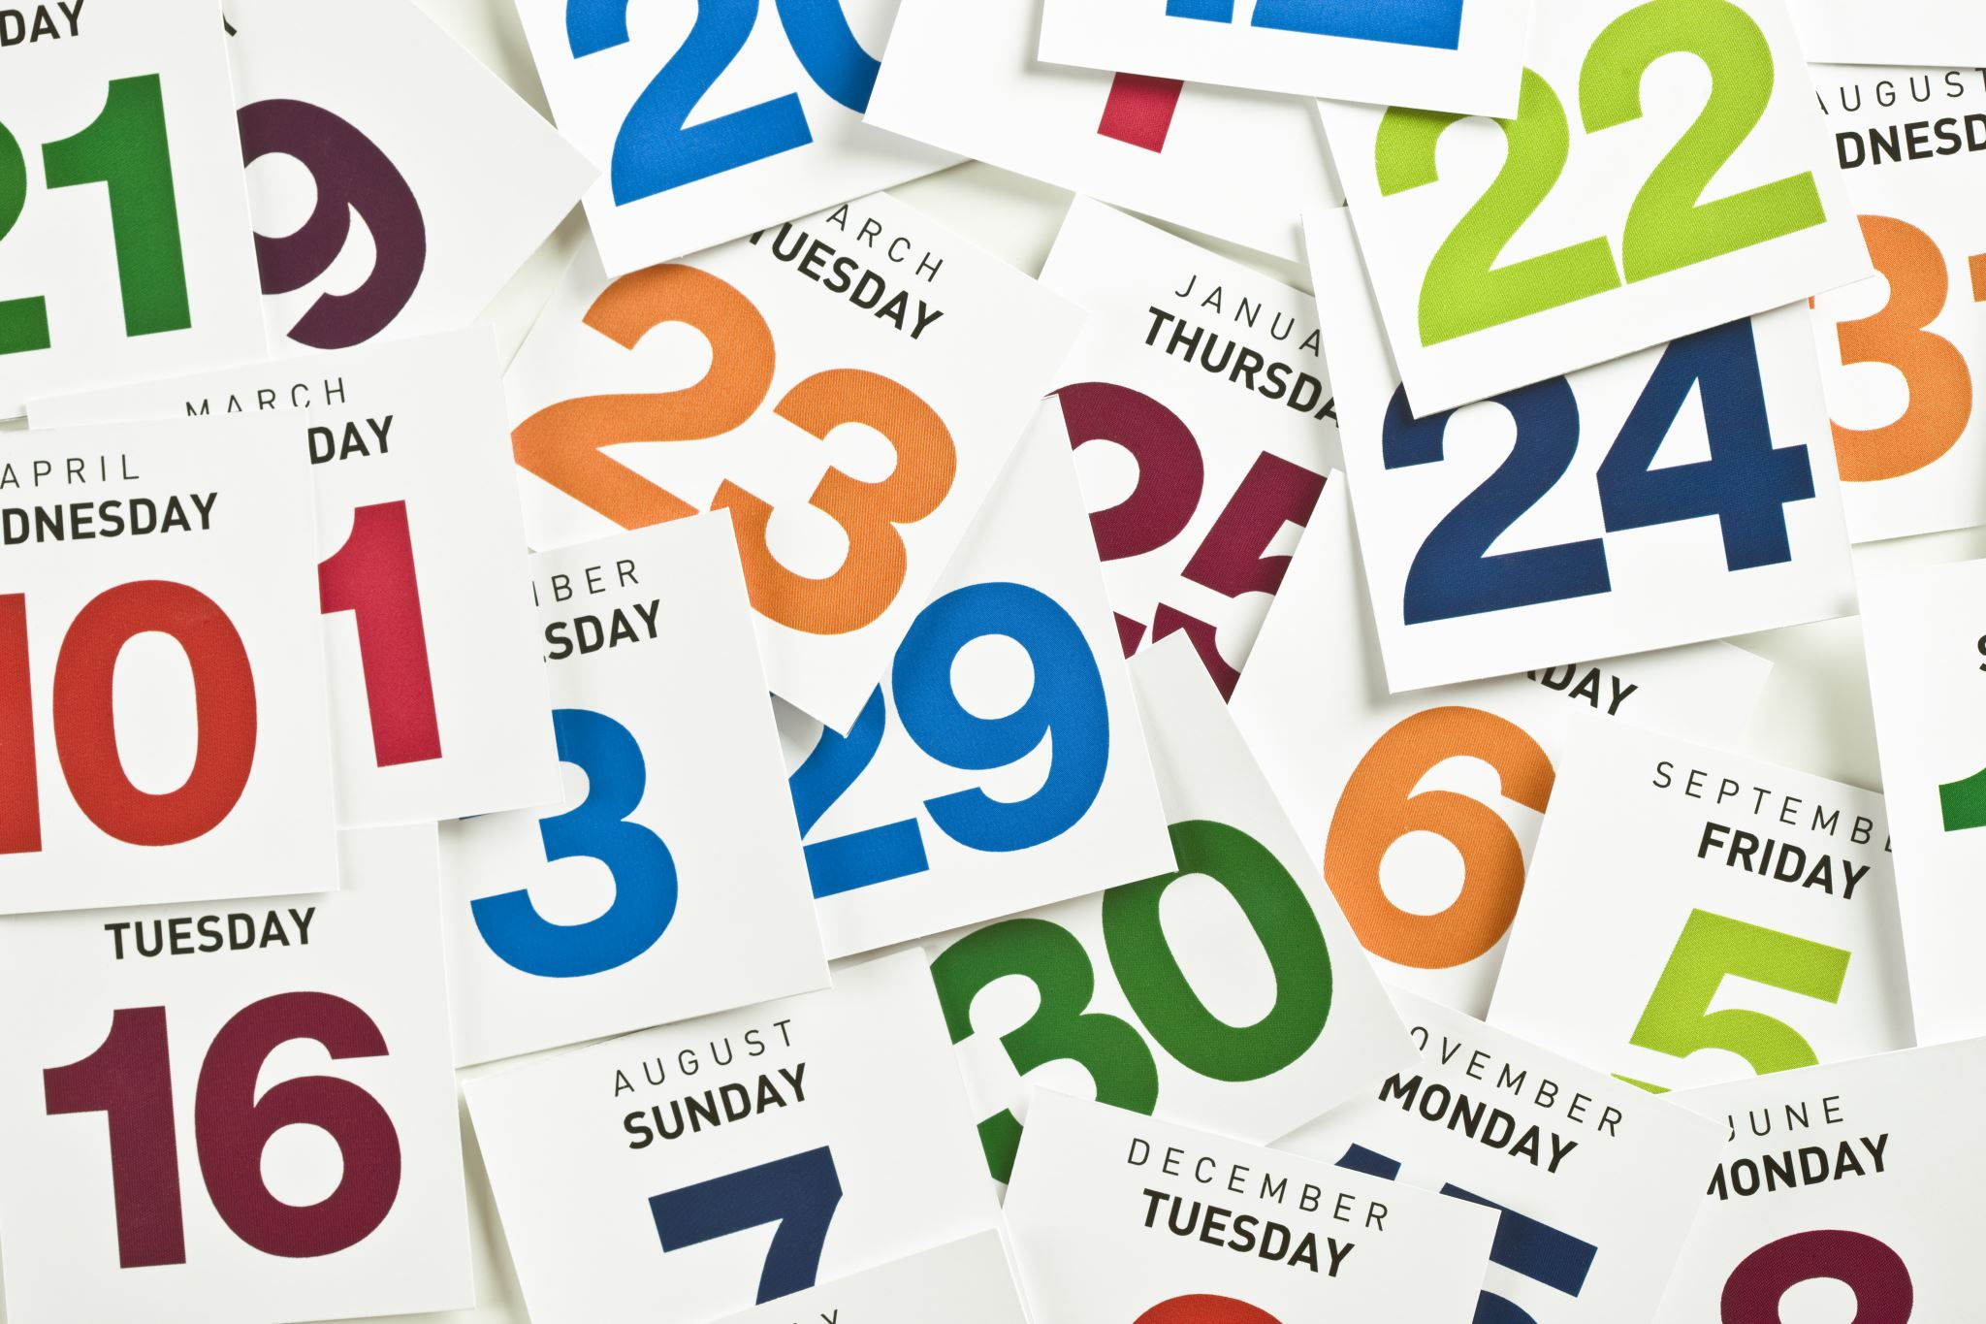
What are you going to do tomorrow?
What are you going to do next week?
What are you going to do next month?
Future Tense With Be Going To Presentation © 2025 by Tiffany Kearns is licensed under CC BY-NC-SA 4.0.
To view a copy of this license, visit https://creativecommons.org/licenses/by-nc-sa/4.0/
Notes:
So, what are you going to do tomorrow? How about next week or next month? What are you going to do? Think about it! Thanks for watching!

