Slide 1
Ending Marks Part 2
Exclamation Marks and Question Marks
Exclamation Marks and Question Marks Presentation © 2025 by Kathini Dreilich is licensed under CC BY-NC-SA 4.0.
To view a copy of this license, visit https://creativecommons.org/licenses/by-nc-sa/4.0/
Notes:
Hi everybody. In this video on punctuation, we are going to look at exclamation marks and question marks. These are both types of ending marks. In the previous video, we looked at periods, which is also a type of ending mark.

Slide 2
exclamation mark
Notes:
This ending mark is called an exclamation mark. It is made up of a period with a straight line above it. The word “exclaim” means to shout. Authors use exclamation marks to add excitement or emphasis to a story. Much like periods, exclamation marks come at the end of a complete sentence.

Slide 3
Don’t go in there
!
Notes:
When you read a sentence with an exclamation mark, you need to make your voice louder and stronger for the whole sentence, not just for the last word, like this: “Don’t go in there!”

Slide 4
question mark
Notes:
This is a question mark. It is made up of a period with a curved line above it. If a sentence is a question, it must have a question mark at the end. The question mark shows us that someone is wondering something or wants to find out information.

Slide 5
Where did everybody go
?
Notes:
When you read a question, your voice needs to go up, like this: Where did everybody go?

Slide 6
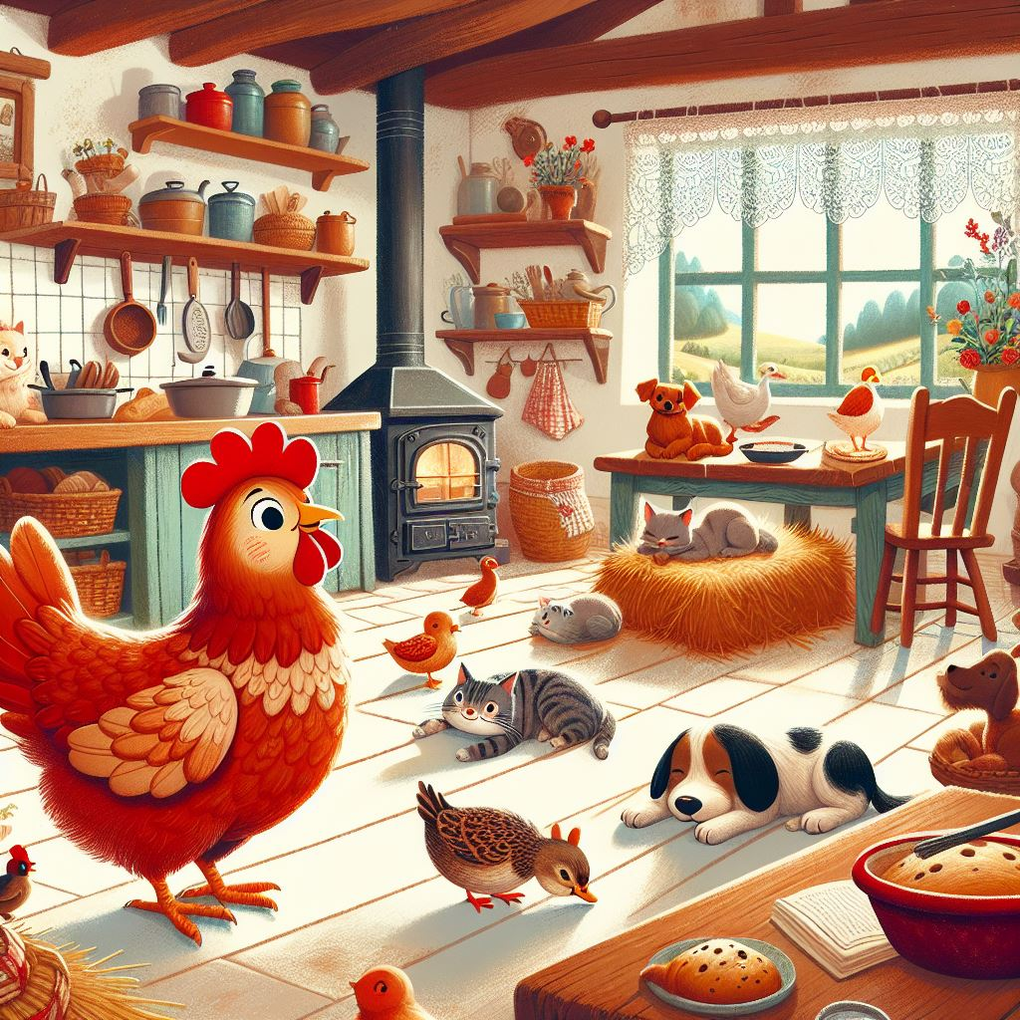
Once upon a time, there was a Little Red Hen who lived on a farm. One day, she found some grains of wheat.
"Who will help me plant these grains?" she asked.
"Not I!" said the lazy dog. "Not I!" said the sleepy cat. "Not I!" said the noisy duck.
"Then I will do it myself!" said the Little Red Hen. And she did.
Notes:
Whenever we read, we need to take a quick look to the ending marks so that we know how to read the sentence. Here is the beginning of the story The Little Red Hen. You will notice that this story has periods [click], a question mark [click] and some exclamation marks [click]. Here is how this story sounds:

Slide 7
Once upon a time, there was a Little Red Hen who lived on a farm. One day, she found some grains of wheat.
"Who will help me plant these grains?" she asked.
"Not I!" said the lazy dog. "Not I!" said the sleepy cat. "Not I!" said the noisy duck.
"Then I will do it myself!" said the Little Red Hen. And she did.
Notes:
[click] Once upon a time, there was a Little Red Hen who lived on a farm. One day, she found some grains of wheat. [click 2] "Who will help me plant these grains?" she asked. [click 2] "Not I!" said the lazy dog. "Not I!" said the sleepy cat. "Not I!" said the noisy duck. [click 2] "Then I will do it myself!" said the Little Red Hen. And she did. {click 2]

Slide 8
. ! ?
Did you learn something about ending marks?
I hope you did.
Thank you very much!
Exclamation Marks and Question Marks Presentation © 2025 by Kathini Dreilich is licensed under CC BY-NC-SA 4.0.
To view a copy of this license, visit https://creativecommons.org/licenses/by-nc-sa/4.0/
Notes:
Did you learn something about ending marks? I hope you did. Thank you very much!

