Slide 1
’
Apostrophes for Contractions
Contractions Presentation © 2025 by Kathini Dreilich is licensed under CC BY-NC-SA 4.0.
To view a copy of this license, visit https://creativecommons.org/licenses/by-nc-sa/4.0/
Notes:
Hi everybody. In this video on punctuation, we are going to look at contractions. These are words with missing letters that are joined together with an apostrophe.

Slide 2
’
I
a
m
Notes:
A contraction is one word that is made by putting two words together and using an apostrophe to show that at least one of the letters is left out. [click] For example the words I and am can make the contraction I’m.

Slide 3
’
I m
Notes:
Apostrophes look like a comma, but they come at the top of the line of text, rather than the bottom. No matter where in the word the apostrophe is placed, it always curves to the left, never to the right.

Slide 4
X
Notes:
Contractions are shortened words, so they make our reading sound more casual and less formal.

Slide 5
can + not = can’t
he + is = he’s
she + will = she’ll
we + have = we’ve
Notes:
Here are some examples of contractions: [click] can and not make the contraction can’t; [click] he and is make the contraction he’s; [click] she and will make the contraction she’ll; [click] we and have make the contraction we’ve. In each of these examples, the apostrophe takes the place of the missing letters.

Slide 6
We don’t make sounds for the letters that we can’t see.
Notes:
We can look at the apostrophe and figure out what letters are missing. This helps us understand what the words mean. When we read contractions, we don’t make sounds for the letters that we can’t see.

Slide 7
can
’
no
t
I
’
a
m
I
’
wi
ll
I
’
ha
ve
Notes:
Here are some contractions that we will see in the story The Gingerbread Man. We will see the words can’t, [click] made up of can and not; I’m, [click] made up of I and am; I’ll, [click] made up of I and will; and I’ve, [click] made up of I and have.

Slide 8
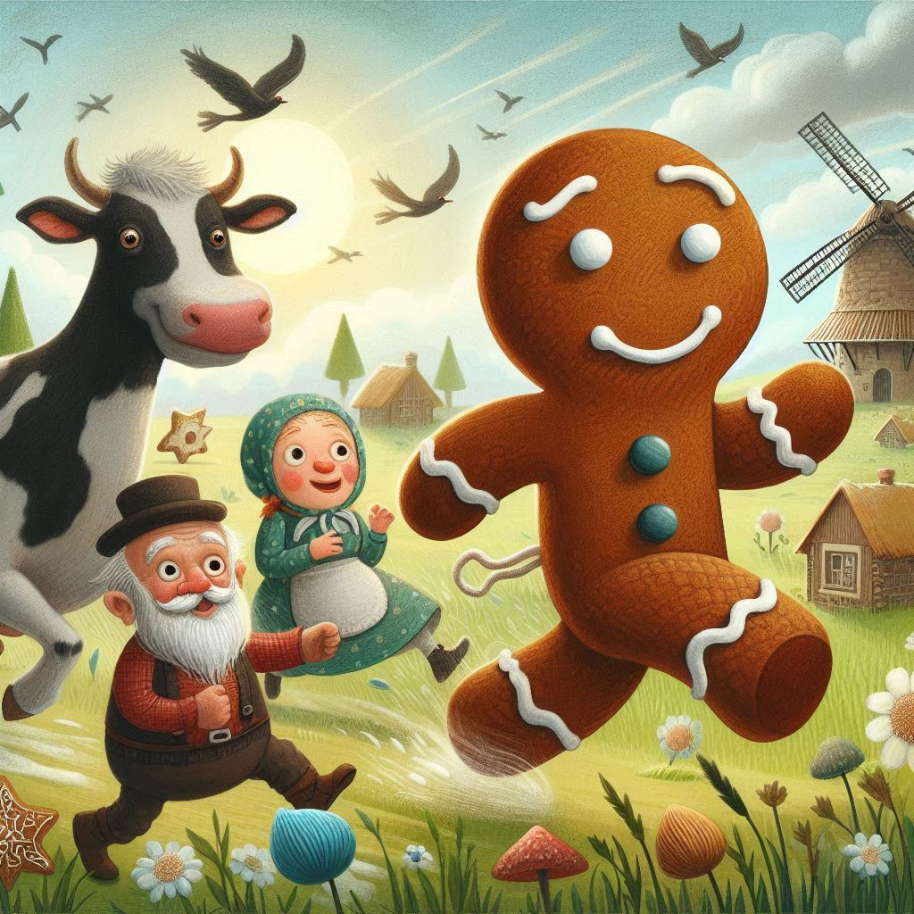
“Run, run, as fast as you can. You can’t catch me I’m the Gingerbread Man!”
Notes:
Here is the story “The Gingerbread Man”: Run, run, as fast as you can. You [click] can’t catch me, [click] I’m the Gingerbread Man!

Slide 9
“I’ve run away from the little old woman.
I’ve run away from the little old man.
And I’ll run from you too! I can, I can!”
Notes:
[click] I’ve run away from the little old woman. [click] I’ve run away from the little old man. And [click] I’ll run from you too! I can, I can!

Slide 10
I’m glad you’ve joined me to learn about contractions and how they’re used to make reading sound more casual.
Contractions Presentation © 2025 by Kathini Dreilich is licensed under CC BY-NC-SA 4.0.
To view a copy of this license, visit https://creativecommons.org/licenses/by-nc-sa/4.0/
Notes:
I’m glad you’ve joined me to learn about contractions and how they’re used to make reading sound more casual. Thank you for watching!

