Slide 1
’
Commas
Commas Presentation © 2025 by Kathini Dreilich is licensed under CC BY-NC-SA 4.0.
To view a copy of this license, visit https://creativecommons.org/licenses/by-nc-sa/4.0/
Notes:
Hi everybody. In this video on punctuation, we are going to look at how to use commas when reading out loud.

Slide 2
,
Notes:
A comma looks like a period with a curved line coming out of the bottom. Commas always curve to the left.

Slide 3
Commas come at the bottom of the line of text, right next to the last letter in the word before.
Notes:
Commas come at the bottom of the line of text, right next to the last letter in the word before.

Slide 4
,
.!?
Notes:
Commas are not a type of ending mark, so you do not fully stop reading when you see a comma.

Slide 5
Take a slight pause, and then continue reading.
Notes:
Instead, you take a slight pause and then continue reading. Commas can give you a chance to take a quick breath.

Slide 6
I was tired, but I still finished my homework.
Notes:
Commas can help connect two ideas in a sentence. Sometimes they are used along with the words ‘and,’ ‘or,’ or ‘but’. For example: “I was tired, but I still finished my homework.”

Slide 7
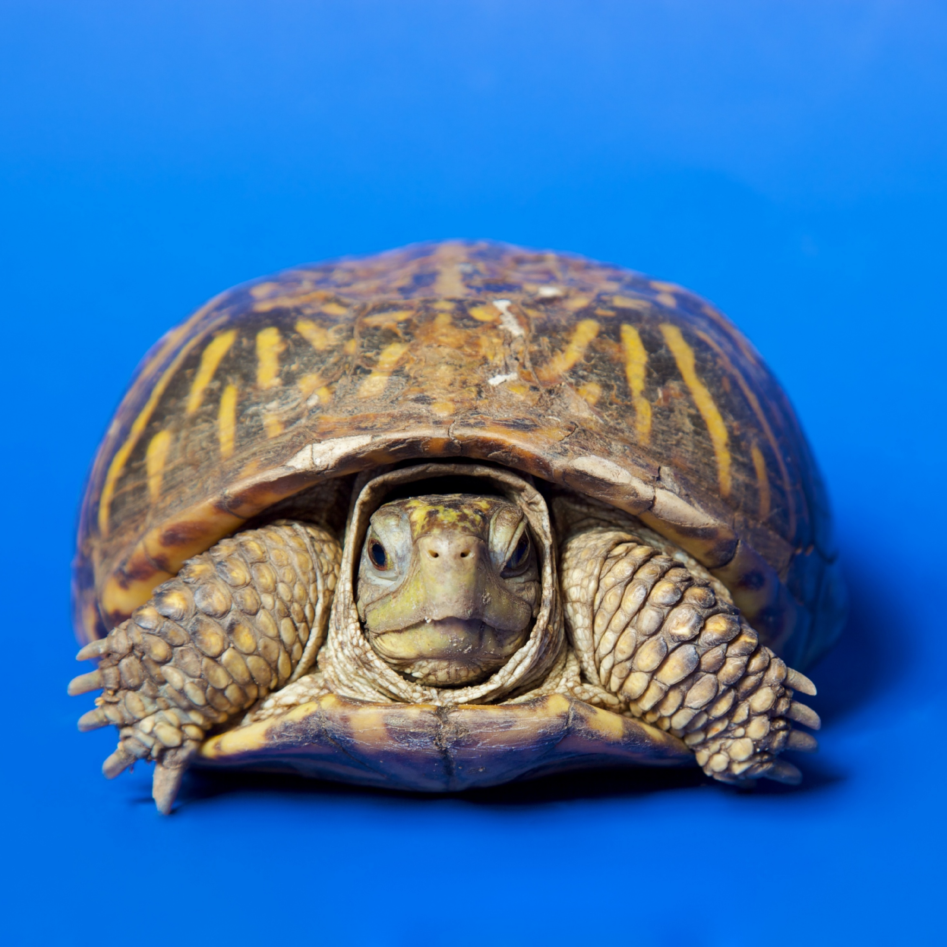
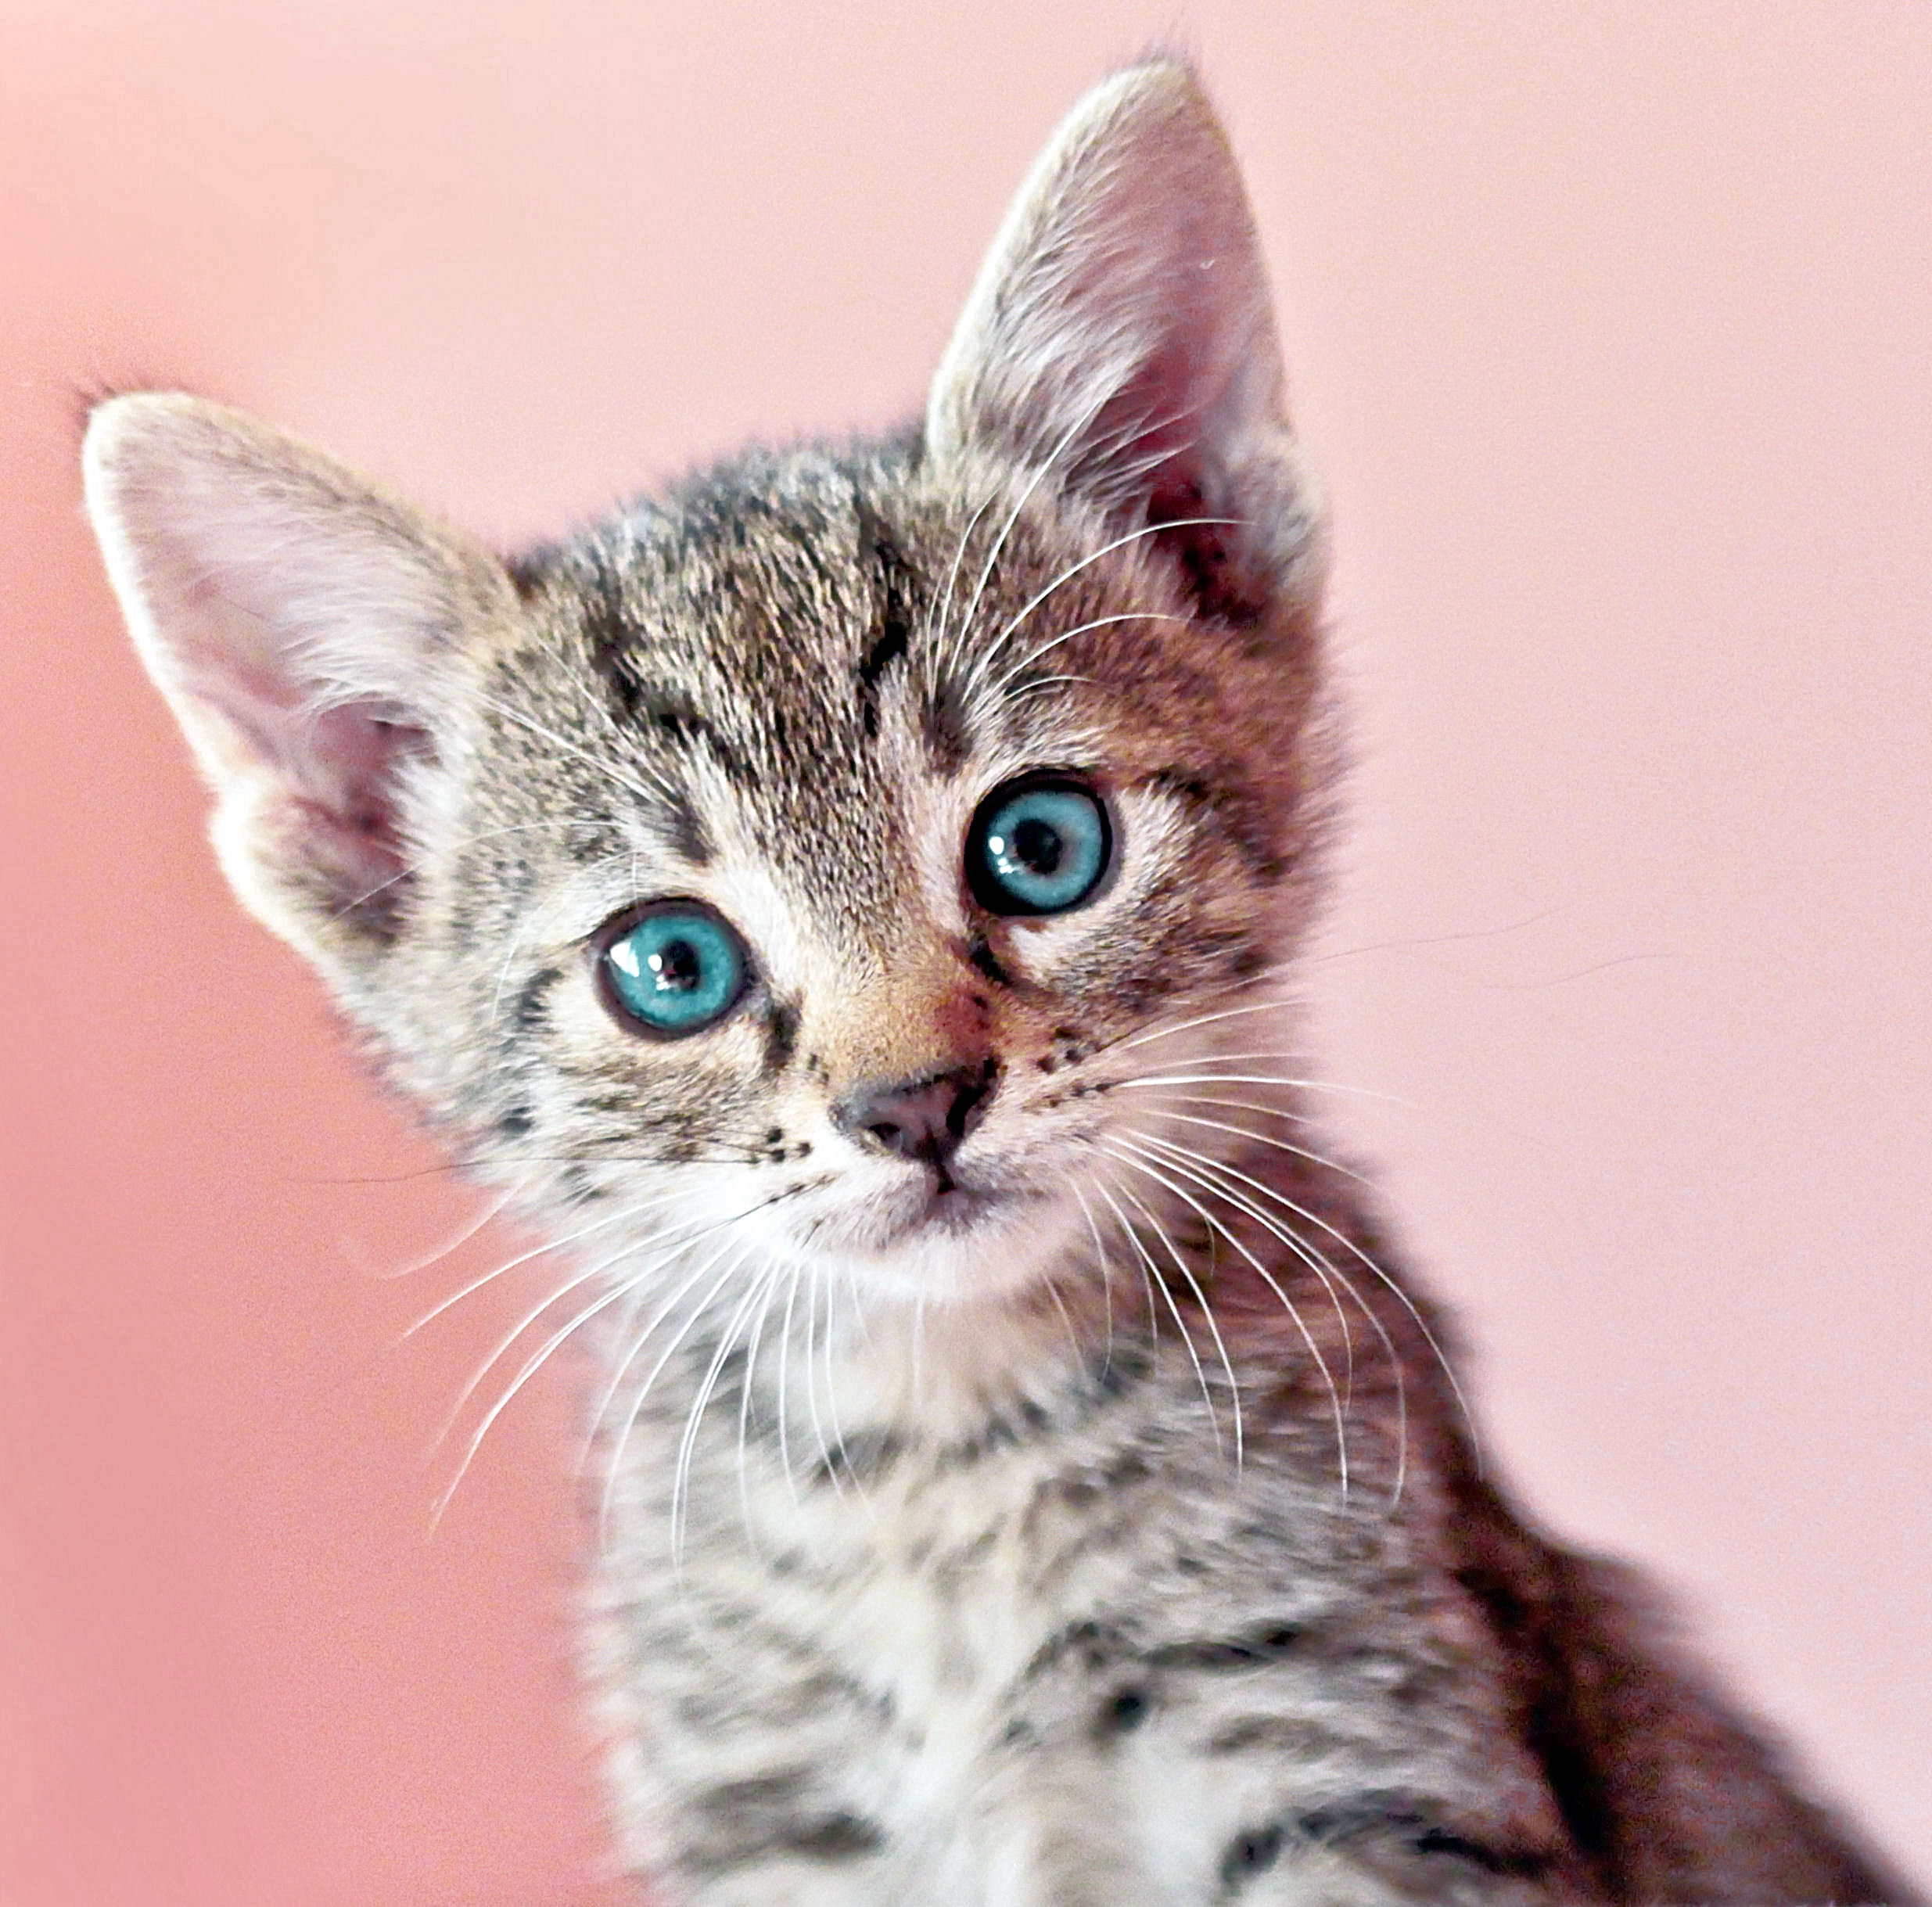
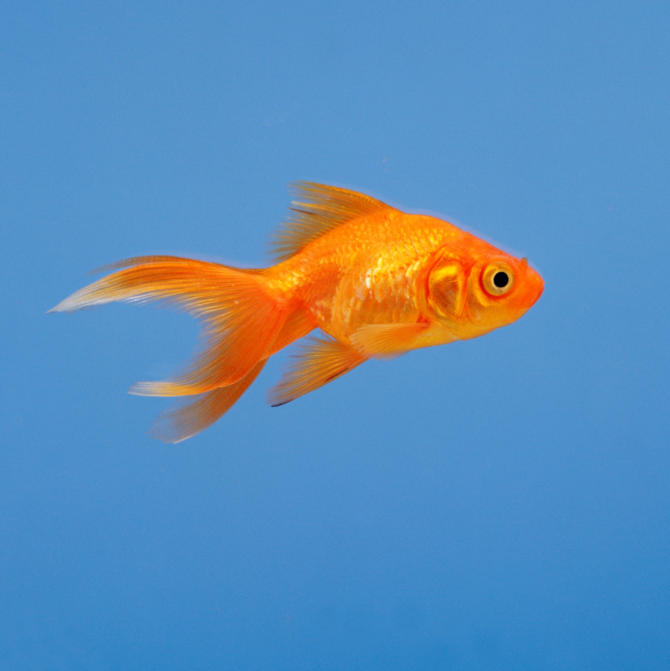
I have a turtle, a cat, a dog, and a fish.
I have a turtle, a cat, a dog, and a fish.
Notes:
Commas are also used to separate items in a list. For example: "I have a turtle, a cat, a dog, and a fish."

Slide 8
Let’s eat, Grandma!
Let’s eat, Grandma!
Notes:
In some situations, if an author left out a comma, it could dramatically change the meaning of the sentence. For example, the sentences: "Let's eat, Grandma!" [click] and "Let's eat Grandma!“ have two very different meanings!

Slide 9
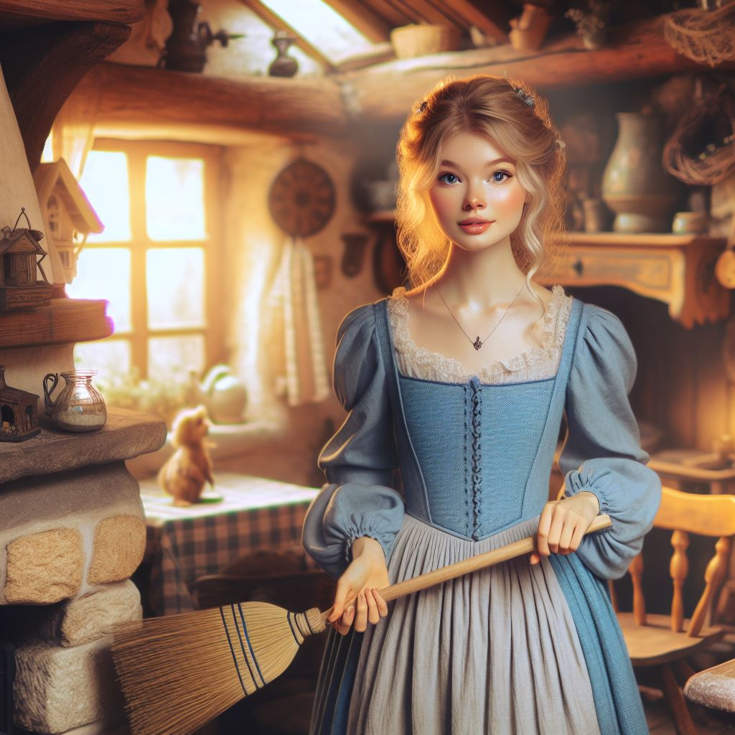
Once upon a time, in a faraway kingdom, there lived a kind, gentle girl named Cinderella. She lived with her wicked stepmother and two stepsisters, who treated her poorly. Every day, Cinderella had to clean the house, cook the meals, and do the laundry.
Notes:
As you listen to me read the beginning of the story Cinderella, follow along so that you can notice how my voice pauses at the commas.

Slide 10
Once upon a time, in a faraway kingdom, there lived a kind, gentle girl named Cinderella. She lived with her wicked stepmother and two stepsisters, who treated her poorly. Every day, Cinderella had to clean the house, cook the meals, and do the laundry.
Notes:
Once upon a time [click], in a faraway kingdom [click], there lived a kind [click], gentle girl named Cinderella. She lived with her wicked stepmother and two stepsisters [click], who treated her poorly. Every day [click], Cinderella had to clean the house [click], cook the meals [click], and do the laundry.

Slide 11
,
Thank you, everyone, for watching this video on commas, and I hope you enjoyed it.
Commas Presentation © 2025 by Kathini Dreilich is licensed under CC BY-NC-SA 4.0.
To view a copy of this license, visit https://creativecommons.org/licenses/by-nc-sa/4.0/
Notes:
Thank you, everyone, for watching this video on commas, and I hope you enjoyed it.

