Slide 1
Basic Tenses
Summary
Basic Tenses Summary Video © 2025 by Tiffany Kearns is licensed under CC BY-NC-SA 4.0.
To view a copy of this license, visit https://creativecommons.org/licenses/by-nc-nd/4.0/
Notes:
This video is a summary of the basic tenses of present, past, and future.

Slide 2
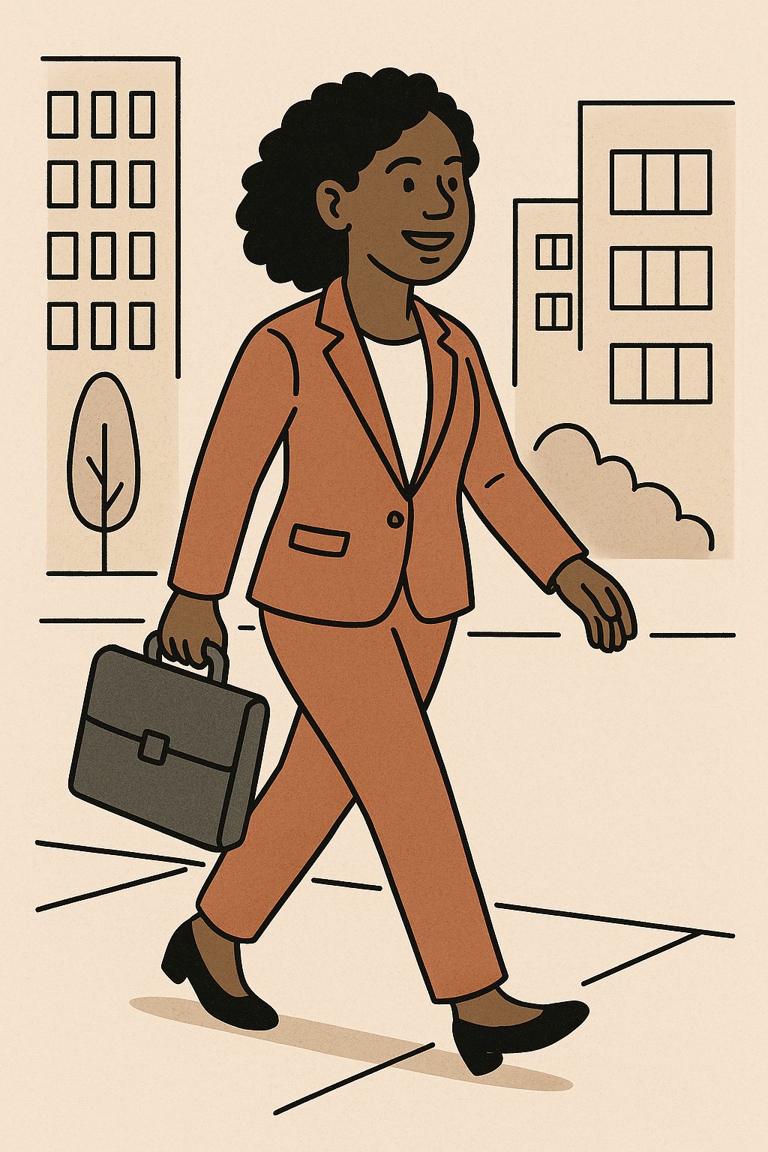
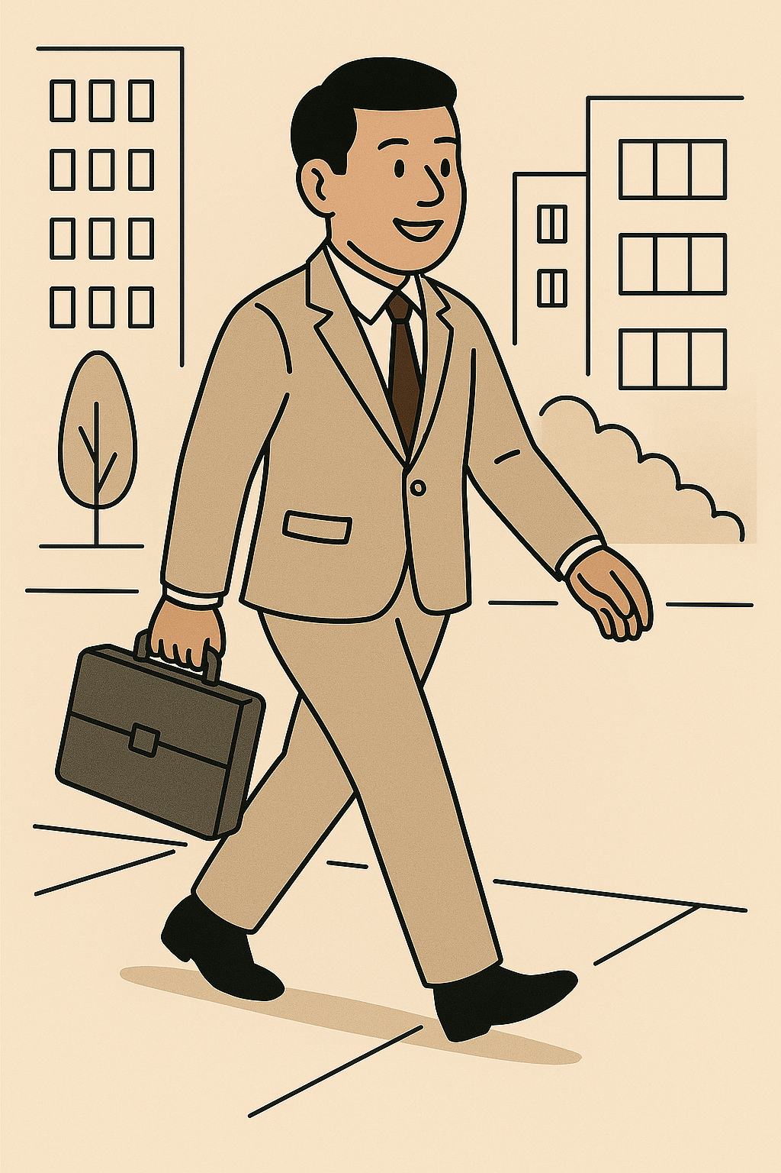
Simple Present
routines or habits
I always walk to work.
He usually walks to work.
Notes:
Use simple present when you are talking about routines or habits. I always walk to work. Remember you can use a frequency adverb to tell how often something is done. In this case always. He usually walks to work. The frequency adverb is usually. Remember with the third person singular you need to add an ‘s’ to the verb.

Slide 3
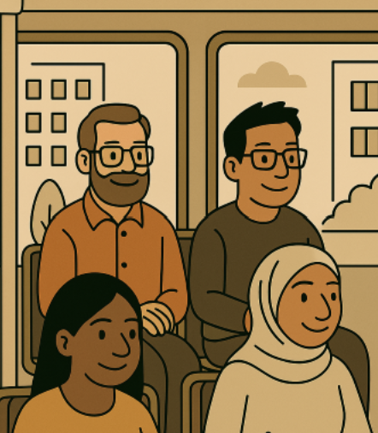
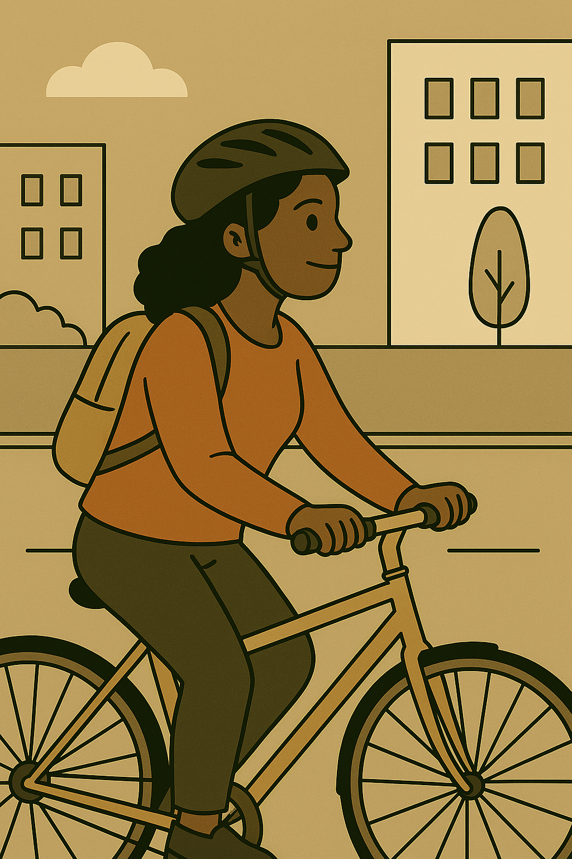
Simple Present - Negative
(do not)
They don’t walk to work.
They take the bus.
(does not)
She doesn’t walk to work.
She rides her bike.
Notes:
When forming the negative, remember to use do not or don’t. They don’t walk to work. They take the bus. And use does not or doesn’t – She doesn’t walk to work. She rides her bike. Remember that the third person singular ‘s’ is on doesn’t and not the main verb.

Slide 4
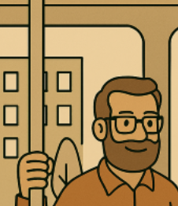
Simple Present - Questions
Do
you walk to work?
Yes, I do.
No, I don’t.
Yes, he does.
No, he doesn’t.
Does
he walk to work?
Notes:
When forming questions, use do or does, depending on the subject. Do you walk to work? Yes I do or no I don’t. Does he walk to work? click Yes he does or no he doesn’t. Remember that with questions, the third person singular ‘s’ is on does, not the main verb.

Slide 5
Present Continuous
actions happening now
She is walking to work.
They are taking the bus.
Notes:
When we are talking about actions that are happening now, we use present continuous tense. For example, She is walking to work, They are taking the bus. Remember to use the correct form of the be verb and then add –ing to the main verb.

Slide 6
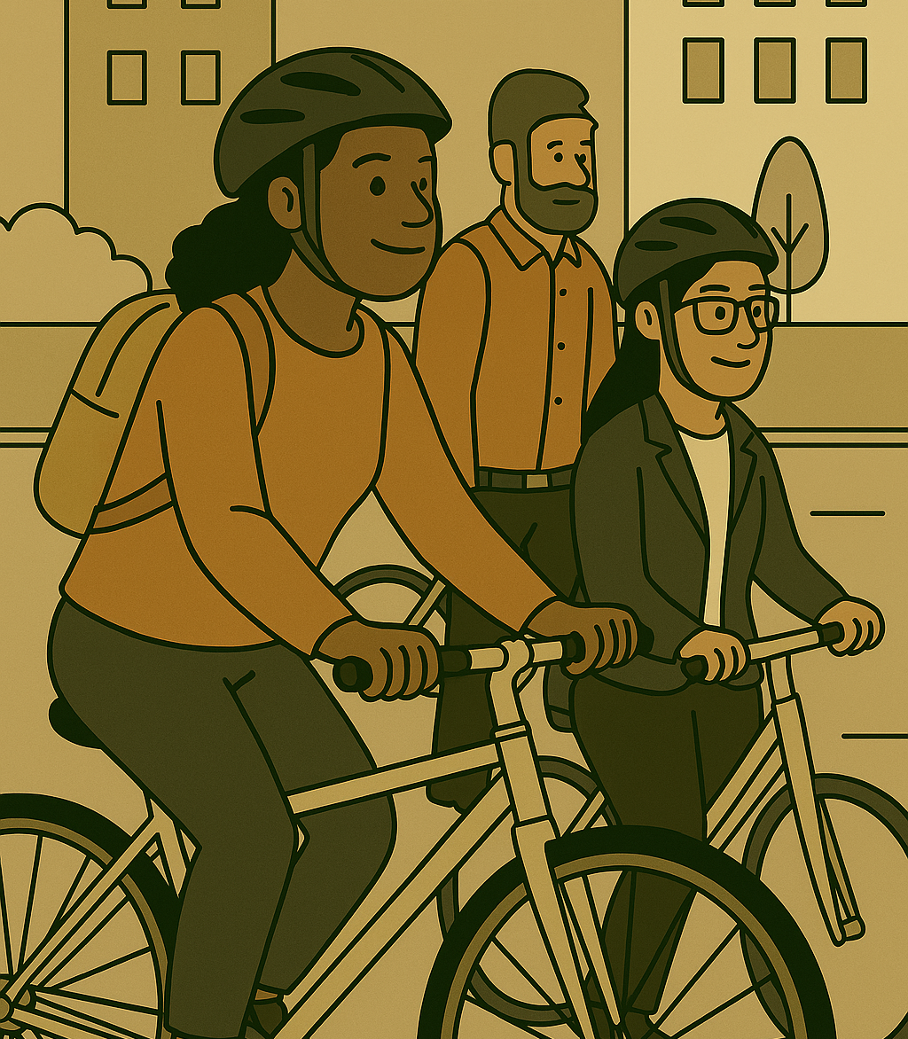
Present Continuous - Negative
(is not)
She isn’t walking to work.
(are not)
They aren’t taking the bus.
Notes:
To form the negative, remember to add not to the be verb of the sentence – For example, she is not or isn’t walking to work. They are not or aren’t taking the bus.

Slide 7
Present Continuous - Questions
Yes, she is.
No, she isn’t.
Is she walking to work?
Are they taking the bus?
Yes, they are.
No, they aren’t.
Notes:
When forming questions, the be verb comes first. For example, Is she walking to work? Yes, she is, or no she isn’t. Are they taking the bus? Yes, they are. Or no they aren’t’. And don’t forget the question mark!

Slide 8
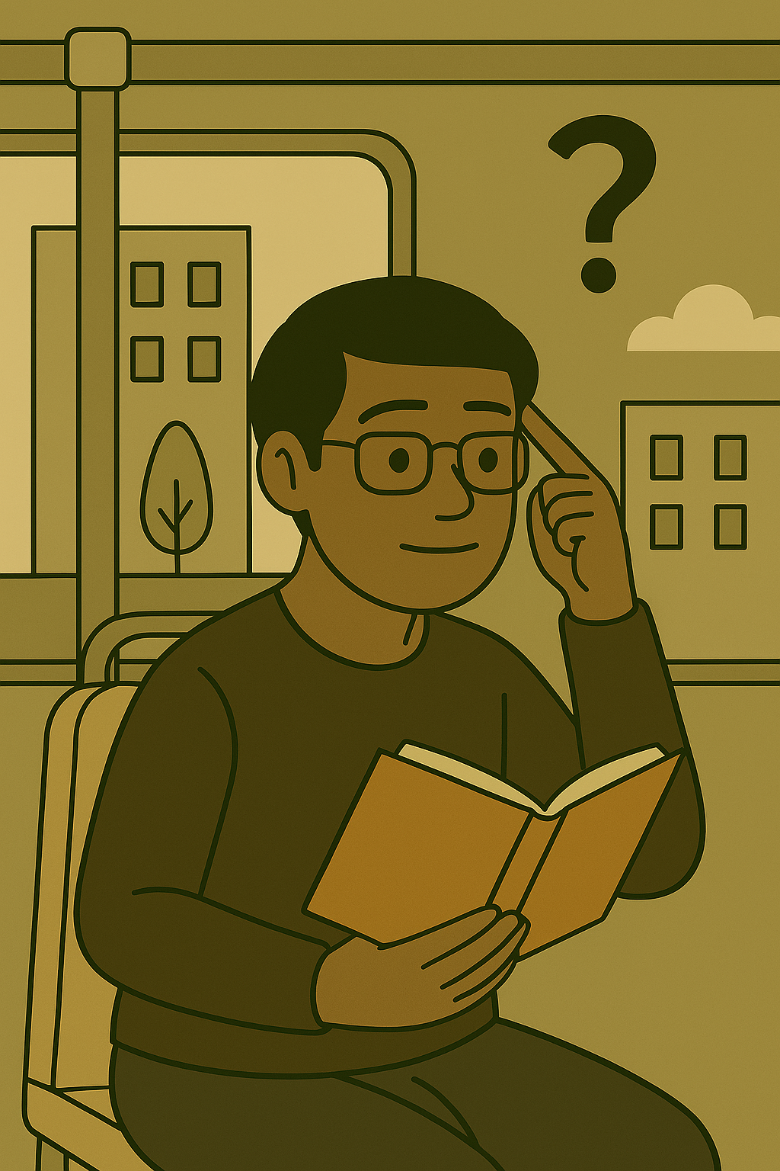
Simple Past
completed actions
Regular Verbs
Irregular Verbs
take
He walked to work yesterday.
They took the bus yesterday.
Notes:
Remember when we want to talk about completed actions in the past we use simple past. There are regular verbs and irregular verbs. For example, He walked to work yesterday. For regular verbs we add ‘ed’ click to the base form of the main verb. They took the bus yesterday. Took click is the irregular past form of take. For irregular past forms, there are no tricks, we just have to remember them.

Slide 9
Simple Past - Negative
Regular Verbs
Irregular Verbs
did not
did not
He didn’t walk to work yesterday.
They didn’t take the bus yesterday.
Notes:
In the negative, for both regular and irregular verbs, we use did plus not - or didn’t. Then the main verb in base form. For example, He didn’t walk to work yesterday. They didn’t take the bus yesterday. Notice again that the main verbs are in base form.

Slide 10
Simple Past - Questions
Regular Verbs
Irregular Verbs
Did he walk to work yesterday
Did they take the bus yesterday
Yes, they did.
No, they didn’t.
Yes, he did.
No, he didn’t.
Notes:
For questions in simple past, begin with did. The main verb will be in base form. For example: Did he walk to work yesterday? Yes he did or not he didn’t. Did they take the bus yesterday? Yes they did or no they didn’t. Remember the main verb is in base form. Don’t forget that question mark!

Slide 11
Future
actions that have not happened yet
be going to
will
They will take the bus to work tomorrow.
She is going to ride her bike to work.
Notes:
And finally let’s review the future tense. This tense is for actions that have not happened yet. They are going to happen or will happen click. For example, She is going to ride her bike to work. They will take the bus to work tomorrow.

Slide 12
Future - Negative
be going to
will
is not
will not
They won’t ride their bikes to work tomorrow.
She isn’t going to take the bus to work next week.
Notes:
For the negative we use not. So, click She isn’t going to take the bus to work next week. And They won’t ride their bikes to work tomorrow. Remember isn’t is a contraction of is not and won’t click is a contraction of will not.

Slide 13
Future - Questions
be going to
will
Will they ride their bikes to work tomorrow?
Is she going to take the bus to work next week?
Yes, they will.
No, they won’t.
Yes, she is.
No, she isn’t.
Notes:
For questions, remember to start with the correct form of be or will. For example, Is she going to take the bus to work next week? Yes, she is, or no, she isn’t. Will they ride their bikes to work tomorrow? Yes, they will or no they won’t. As always, don’t forget the question marks!

Slide 14
Basic Tenses Summary Video © 2025 by Tiffany Kearns is licensed under CC BY-NC-SA 4.0.
To view a copy of this license, visit https://creativecommons.org/licenses/by-nc-nd/4.0/
Notes:
I hope you enjoyed this interactive book on basic tenses – be sure to send your feedback or questions by email. We are always open to hearing about how we can improve our content.

